Slide 1
Distinguished Lecturer Program

Slide 2
Acknowledgement
The presenter wishes to acknowledge the IEEE Sensors Council for their kind support under the Distinguished Lecturer program.

Slide 3
Who are we?
An IEEE entity devoted to sensors, or “the theory, design, fabrication, manufacturing, reliability and applications of devices for sensing and transducing physical, chemical, and biological phenomena.”
Sensors are a cross-cutting subject among many IEEE disciplines.
Hence, a ‘Council” has been formed.
The IEEE Sensors Council covers Sensors in the field of 26 IEEE Technical Societies.

Slide 4
Distinguished Lecturers Program (DLP) 2020
Objective
Highlights
Information
Access experts promoting the field of sensors.
Currently 9 DLs with various backgrounds and geo-locations
Online Biography and Talk Titles (addition of video)
Each graduating DL produces a recorded tutorial.
Distinguished Lecturer Program:
ieee-sensors.org/dlp

Slide 5
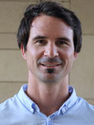
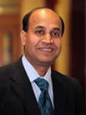
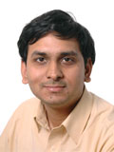
Class of 2020 (Duration 2020-2022)
Jürgen Kosel
King Abdullah University of Science and Technology
Thuwal, Saudi Arabia
Talks:
Wearable Magnetic Skins and Sensors
Wearable Printed Graphene Sensors
Subhas Chandra Mukhopadhyay
Macquarie University
Sydney, Australia
Talks:
IoT and WSN for Health and Home Management
WSN, Smart Homes, and Intelligent Buildings: From sensors to computing
Trends for Wearable and Medical Devices
Ashwin A. Seshia
University of Cambridge
Cambridge, England
Talks:
Vibrating Beam MEMS Accelerometers for Gravity and Seismic Measurements
Nonlinear Dynamics in Microelectromechanical Systems
DL Name and Affiliation
Topics of Interest

Slide 6
Class of 2019 (Duration 2019-2021)
Rudra Pratap
Minghong Yang
Wuhan University of Technology Wuhan, China
Talks:
Optical Fiber Sensing Technologies Based On Sensitive Thin Films and Coatings
Thousands of Fiber Grating Sensor Array Based on Draw Tower; A New Platform for Fiber-Optic Sensing
Ravinder Dahiya
University of Glasgow
Glasgow, Scotland
Talks:
Large Area Electronic Skin
Tactile Skin in Robotics and Medical Applications
DL Name and Affiliation
Indian Institute of Science
Bangalore, India
Talks:
How Do Crickets Sing So Loudly? The Mechanics Behind Nature’ Micro-Transducer Orchestra
Discovering Templates of Engineering Design Hidden in Nature’s Transducer
Topics of Interest

Slide 7
Class of 2018 (Duration 2018-2020)
John Kitching
National Institute of Standards and Technology
Boulder, CO, USA
Talk:
Chip-scale Atomic Devices Miniature Precision Instruments using Atoms, Lasers, and Silicon Micromachining
Veena Misra
North Carolina State University Raleigh, NC, USA
Talk:
Self-Powered Wearable Sensors for Health and Environmental Monitoring
Paul C.-P. Chao
National Chiao Tung University
Taiwan
Talks:
Towards Battery-less IoT Sensors
A New Handheld Cuff-less Photoplethysmography Sensor for Continuous Blood Volume Measurement
DL Name and Affiliation
Topics of Interest

Slide 8
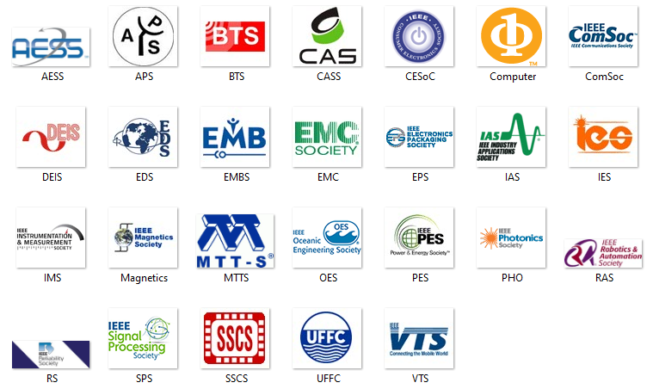
Sensor Council’s 26 Member Societies

Slide 9
What can the Council do for you?
Conferences
Standards
Publications
Education
Technical Activities
Networking

Slide 10
Conferences
Annual Flagship Conference
Inertial Sensors & Systems
Flexible and Printable Sensors and Systems
Internet of Things
2020: Hiroshima, Japan
2020: Manchester, UK
2020: Rotterdam, Netherlands
2020: New Orleans, LA, USA
Visit Ieee-sensors.org

Slide 11
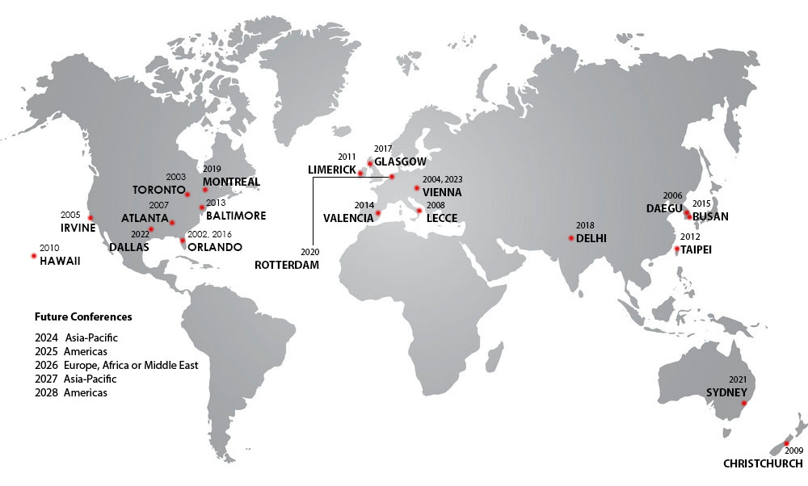
IEEE Sensors Conference
3-year international geographic rotation:
Americas
Europe/Middle-East/Africa
Asia/Pacific

Slide 12
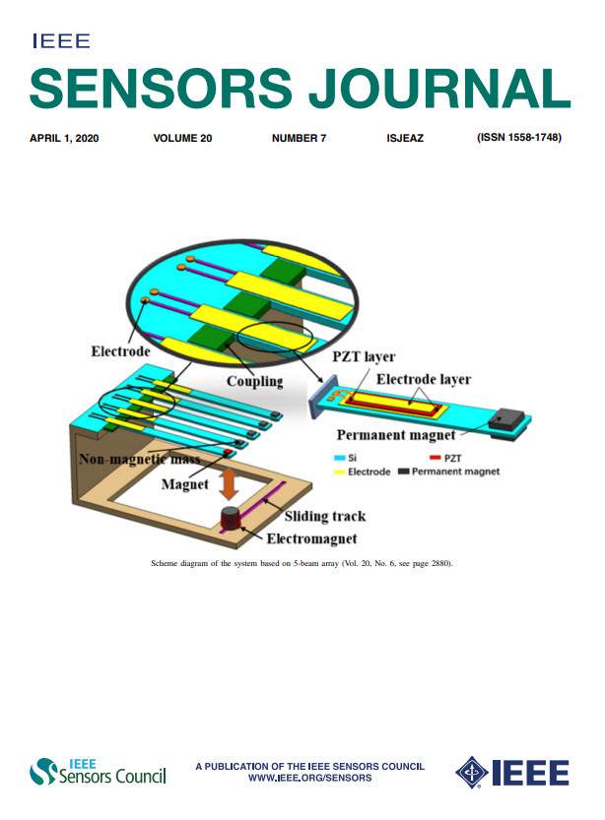
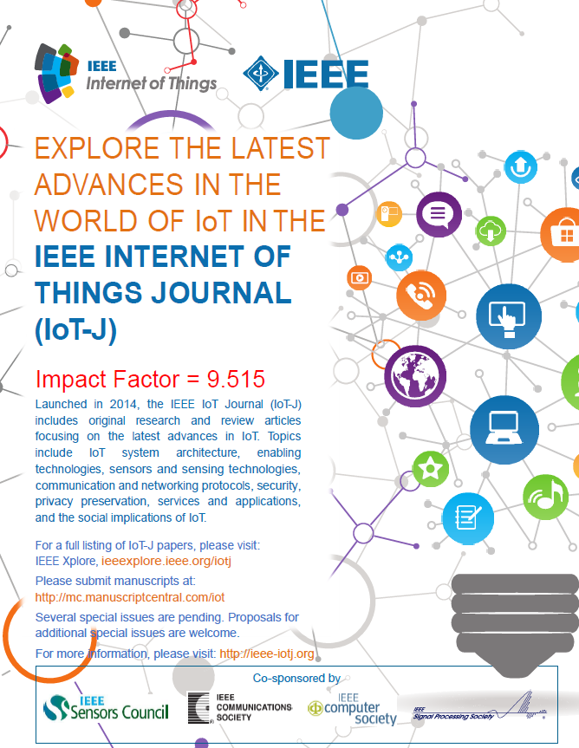
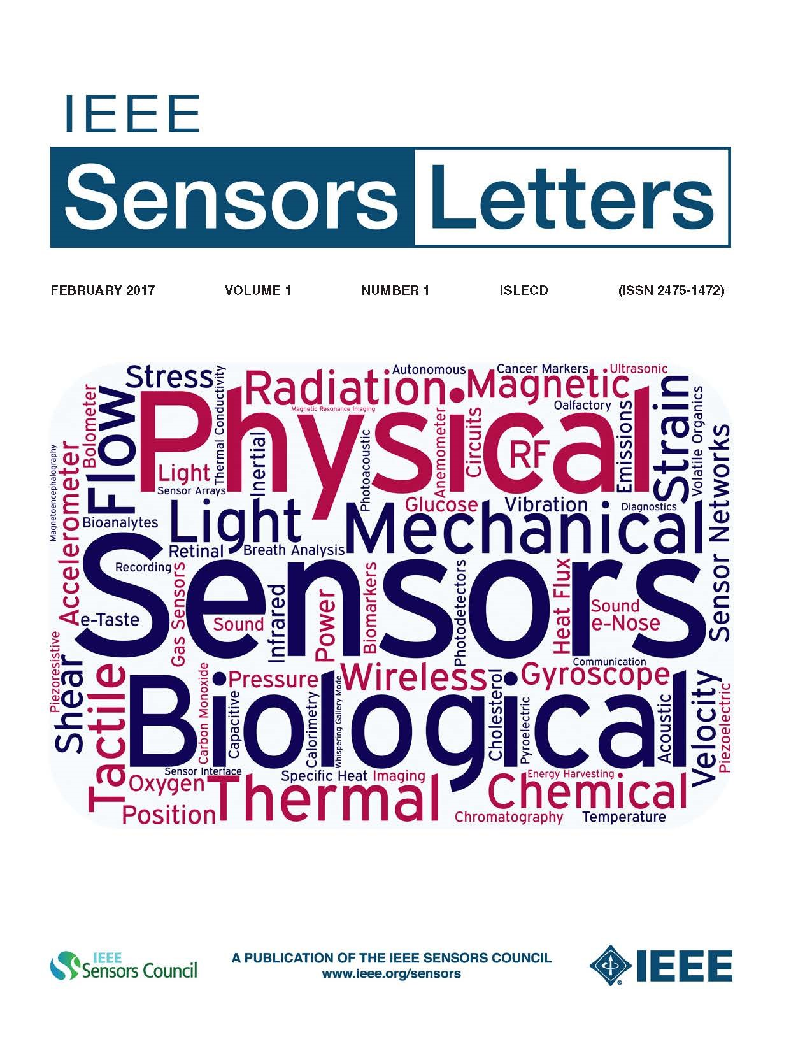
Publications
IEEE Sensors Journal
IEEE Sensors Letters
Established 2001
871k downloads in 2018
Impact factor 3.076
Median time-to-publication <7 weeks
Launched in 2017
Rapid publication of short papers
Co-Sponsored Publications:
IEEE Internet of Things Journal
IEEE Trans. on Big Data (T-Big Data)
IEEE Trans. on Games (T-GAMES)
IEEE Journal of Electromagnetics, RF and Microwaves in Medicine and Biology (J-ERM)
IEEE Journal on Miniaturization for Air and Space Systems (J-MASS)

Slide 13
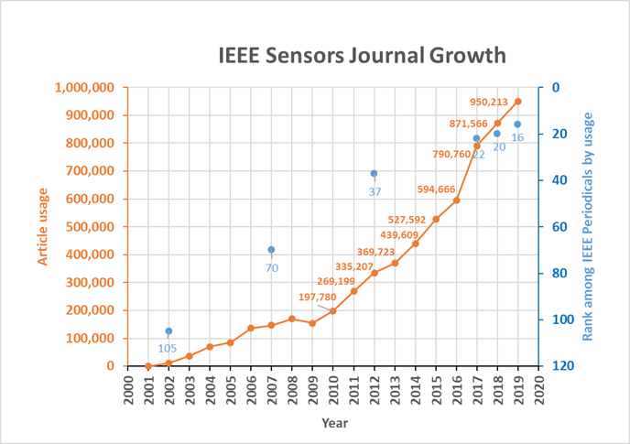
IEEE Sensor Journal

Slide 14
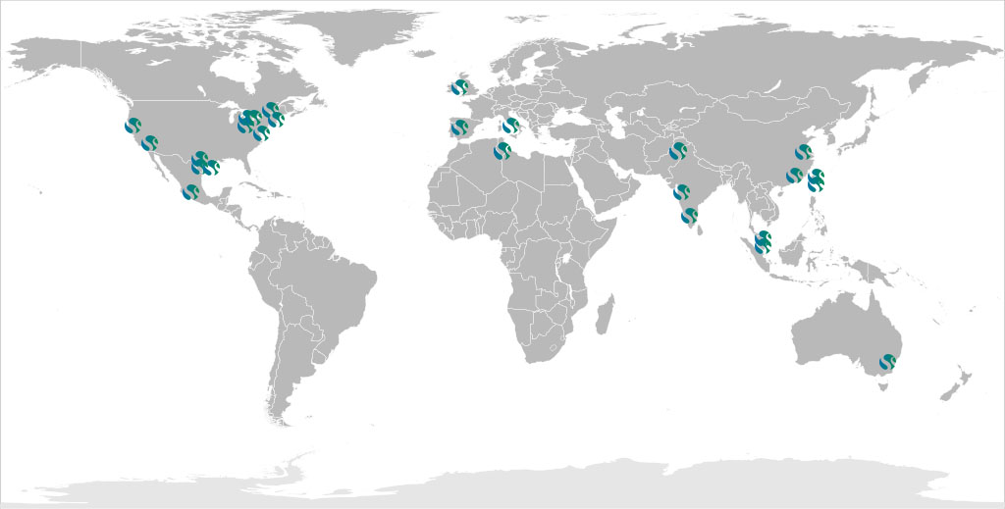
IEEE Sensors Council Chapters/
Joint Chapter Locations

Slide 15
YouTube Education
Visit and subscribe to our YouTube Channel for tutorials, keynote talks, conference presentations, and more
Bit.ly/SensorsCouncilYouTube

Slide 16
Connect with us on Social Media!
Internet of Things
@SensorsCouncil
@IEEESENSORS
IEEE Sensors Council
@IEEESensorsCouncil
@IEEESENSORS
2020: New Orleans, LA, USA

