Slide 1

ieee-sensors.org

Slide 2
About the Sensors Council
Formed in 1999
An IEEE entity devoted to sensors, theory, design, fabrication, manufacturing, reliability and applications of devices for sensing and transducing physical, chemical, and biological phenomena, with emphasis on the electronics, physics and reliability aspects of sensors and integrated sensor-actuators.
Activities include publications, conferences, Distinguished Lecturers, and more.
Sensors are a cross-cutting subject among many IEEE disciplines.
The IEEE Sensors Council covers Sensors in the field of 26 IEEE Technical Societies.

Slide 3

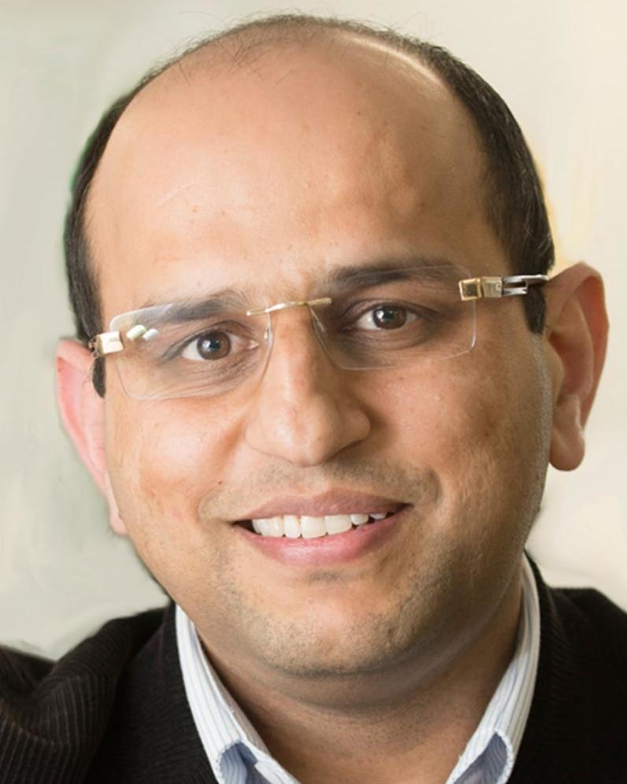
Executive Committee
President
Andrei Shkel
President-Elect
Ravinder Dahiya
Past President
Fabrice Labeau
Past Past President
Mike McShane
VP Finances
Zeynep Çelik
VP Publications
Krikor B. Ozanyan
VP Technical Operations
Anil Roy
VP Conferences
Deepak Uttamchandani
Secretary – Treasurer
Chonggang Wang

Slide 4






What Can the Council Do For You?
As Sensors Council is an IEEE Technical Council and unlike Member Societies, individuals cannot be members of a council. However, IEEE Members can register as Sensors Council participants, receive newsletters, attend Sensors Council sponsored events, and volunteer.
Conferences
Standards
Publications
Education
Technical Activities
Networking

Slide 5
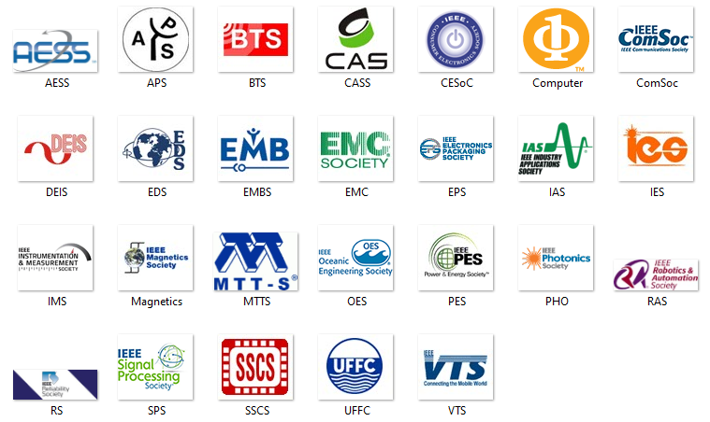
Sensors Council’s 26 Member Societies

Slide 6



Conferences
FLAGSHIP CONFERENCE
IEEE International Conference on Flexible and Printable Sensors and Systems
Virtual Conference
June 20-23, 2021
IEEE SENSORS Conference
Virtual Conference
Oct. 31 – Nov. 3, 2021
IEEE International Symposium on Inertial Sensors and Systems
Avignon, France
March 28-31, 2022
A full list of events and conferences, call for papers, and registration information can be found on ieee-sensors.org/conferences.

Slide 7
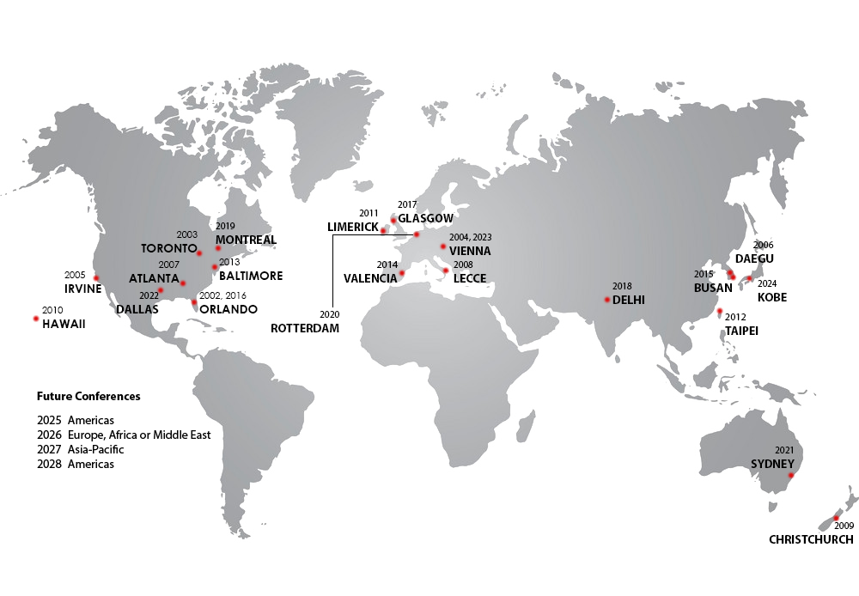

IEEE SENSORS Conference Locations
3-Year International Geographic Rotation
Americas
Europe/Middle-East/Africa
Asia/Pacific

Slide 8




Publications
IEEE Sensors Journal
  Established 2001
  ~1M downloads in 2020
  Impact factor 3.076
  Median time-to-publication <7 weeks
IEEE Sensors Letters
  Launched in 2017
  Rapid publication of short papers
Co-Sponsored Publications
  IEEE Internet of Things Journal
  IEEE Trans. on Big Data
  IEEE Trans. on Games
  IEEE Journal of Electromagnetics, RF and
  Microwaves in Medicine and Biology
Newsletter
  Publishes quarterly
  Reach of over 21,000 subscribers

Slide 9
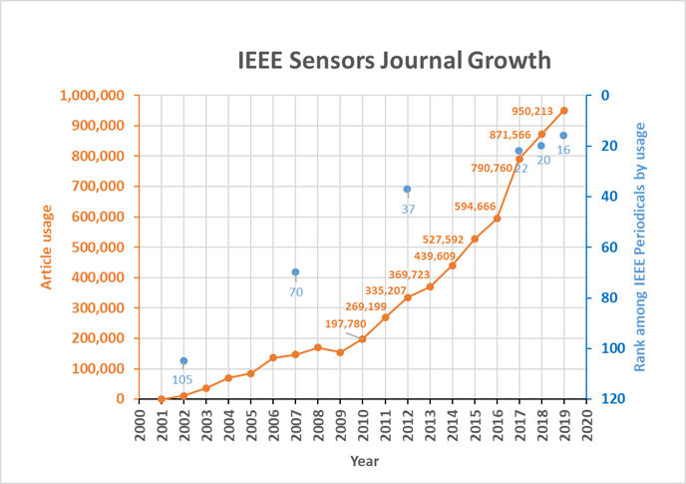
IEEE Sensors Journal

Slide 10
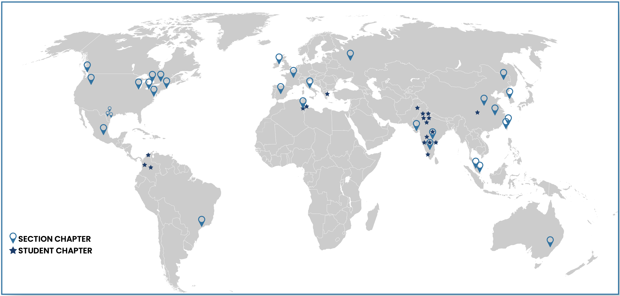
IEEE Sensors Council Chapters/Joint Chapter Locations
(as of April 7, 2021)
33
Section Chapters
22
Student Chapters
18
Countries
9
IEEE Regions

Slide 11



Distinguished Lecturers Program 2021
Objective
Highlights
Information
Access experts promoting the field of sensors.
Currently 10 DLs with various backgrounds and geo-locations
Online Biography and Talk Titles (addition of video)
Request a Distinguished Lecturer for your event by visiting the website and filling out the form.
Calls for new DLs are announced on the website and social media.
ieee-sensors.org/dlp

Slide 12
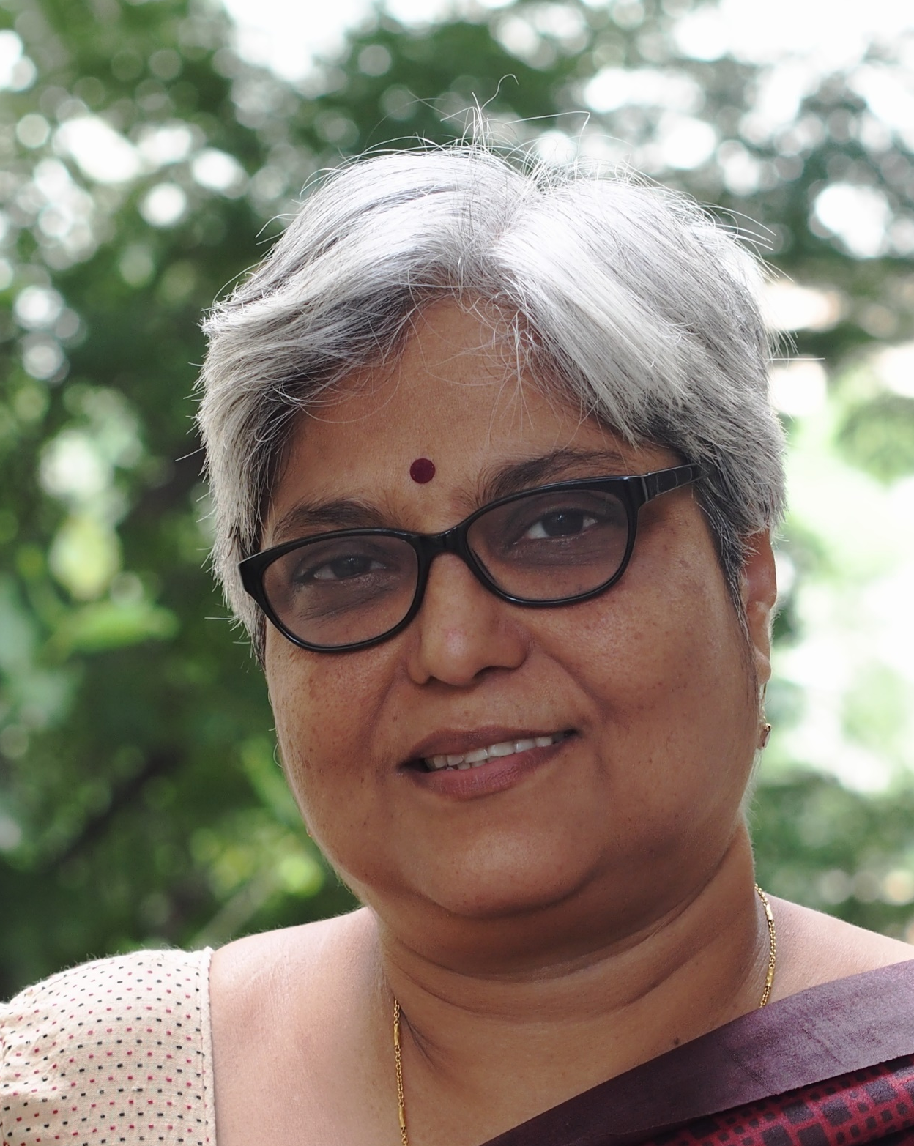
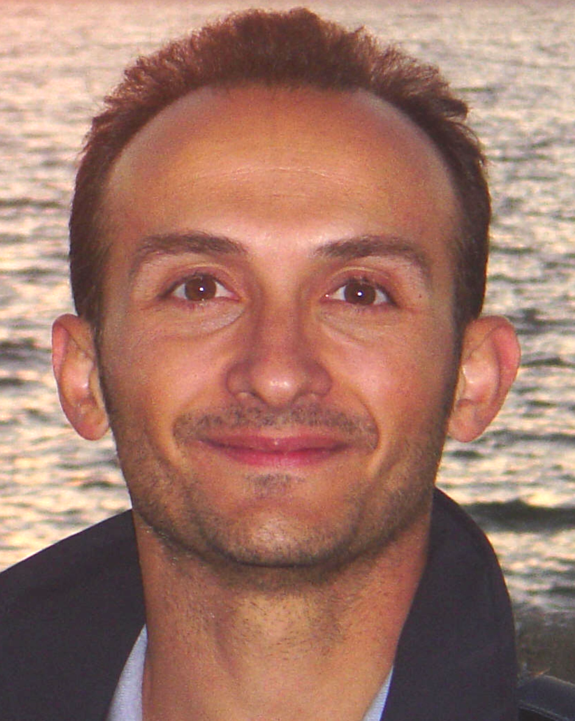
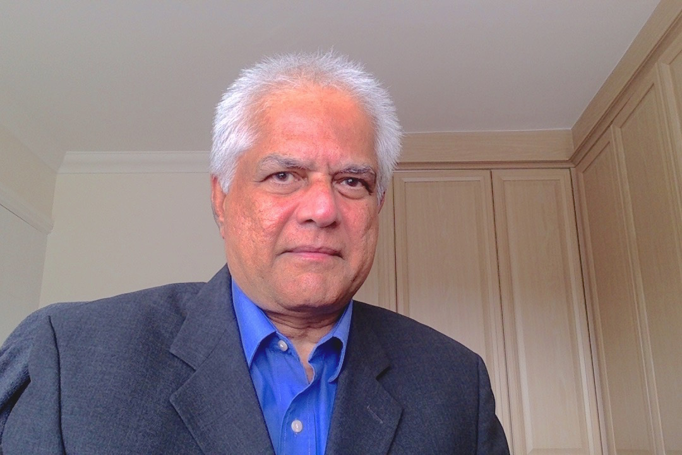

Distinguished Lecturers Program | Class of 2021-2023
Enakshi Bhattacharya
Indian Institute of Technology Madras
Chennai, India
MEMS Pressure Sensors
Miniaturised Electrochemical Silicon Biosensor System for the Detection of Triglycerides
High Sensitivity Bio-sensing in Liquids with Resonant Mode Cantilevers
Giancarlo Fortino
University of Calabria
Rende, Italy
Wearable Computing Systems based on Body Sensor Networks: State-of-the-art and Future Research Challenges
Collaborative Body Sensor Networks and Their Application for Pervasive Humans’ Tracing to combat Pandemics
Vladimir Lumelsky
NASA – Goddard Space Flight Center
Greenbelt, MD, USA
Human-Robot Interaction and Human-Robot Teams
Arokia Nathan
University of Cambridge
Cambridge, England
Ultra Low Power Sensor Interfaces for IoT

Slide 13
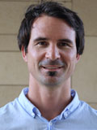
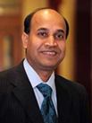
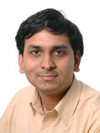
Distinguished Lecturers Program | Class of 2020-2022
Jürgen Kosel
King Abdullah University of Science and Technology
Thuwal, Saudi Arabia
Wearable Magnetic Skins and Sensors
Wearable Printed Graphene Sensors
Subhas Chandra Mukhopadhyay
Macquarie University
Sydney, Australia
IoT and WSN for Health and Home Management
WSN, Smart Homes, and Intelligent Buildings: From sensors to computing
Trends for Wearable and Medical Devices
Ashwin A. Seshia
University of Cambridge
Cambridge, England
Vibrating Beam MEMS Accelerometers for Gravity and Seismic Measurements
Nonlinear Dynamics in Microelectromechanical Systems

Slide 14



Distinguished Lecturers Program | Class of 2019-2021
Ravinder Dahiya
University of Glasgow
Glasgow, Scotland
Large Area Electronic Skin
Tactile Skin in Robotics and Medical Applications
Rudra Pratap
Indian Institute of Science
Bangalore, India
How Do Crickets Sing So Loudly? The Mechanics Behind Nature’ Micro-Transducer Orchestra
Discovering Templates of Engineering Design Hidden in Nature’s Transducer
Minghong Yang
Wuhan University of Technology Wuhan, China
Optical Fiber Sensing Technologies Based On Sensitive Thin Films and Coatings
Thousands of Fiber Grating Sensor Array Based on Draw Tower; A New Platform for Fiber-Optic Sensing

Slide 15


YouTube Education
The Sensor’s Council YouTube channel has over 99,000 views and over 2050 subscribers as of April 1, 2021. The channel features live demonstrations, conference tutorials, plenary talks, invited/keynote talks, oral presentations, DL talks and more.
Bit.ly/SensorsCouncilYouTube

Slide 16






Website
ieee-sensors.org
Facebook
facebook.com/IEEESensorsCouncil
Twitter
@SensorsCouncil
LinkedIn
Stay up to date on Sensors Council news and events!
linkedin.com/company/ieee-sensors-council
YouTube
Bit.ly/SensorsCouncilYouTube
Publicity Resources
ieee-sensors.org/publicity-documents/

