Slide 1

ieee-sensors.org

Slide 2
About the Sensors Council
Formed in 1999
An IEEE entity devoted to sensors, theory, design, fabrication, manufacturing, reliability and applications of devices for sensing and transducing physical, chemical, and biological phenomena, with emphasis on the electronics, physics and reliability aspects of sensors and integrated sensor-actuators.
Activities include publications, conferences, Distinguished Lecturers, and more.
Sensors are a cross-cutting subject among many IEEE disciplines.
Currently, there are 26 IEEE Member Societies represented in Sensors Council.

Slide 3
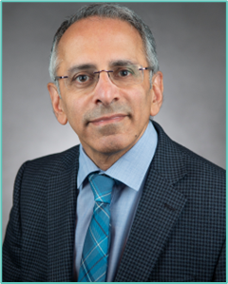
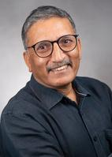
Executive Committee
President
Deepak Uttamchandani
President-Elect
Anil Roy
Past President
Ravinder Dahiya
Past Past President
Andrei Shkel
VP Finances
Srinivas Tadigadapa
VP Publications
Sandro Carrara
VP Technical Operations
Thilo Sauter
VP Conferences
Rolland Vida
VP Educational Activities
Krikor Ozanyan
Secretary - Treasurer
Chonggang Wang

Slide 4






What Can the Council Do For You?
As Sensors Council is an IEEE Technical Council and unlike Member Societies, individuals cannot be members of a council. However, IEEE Members can register as Sensors Council participants, receive newsletters, attend Sensors Council sponsored events, and volunteer.
Conferences
Standards
Publications
Education
Technical Activities
Networking

Slide 5

Sensors Council’s 26 Member Societies

Slide 6



Conferences
FLAGSHIP CONFERENCE
IEEE International Conference on Flexible, Printable Sensors and Systems
Tampere, Finland
June 30 – July 3, 2024
IEEE SENSORS Conference
Kobe, Japan
October 20-23, 2024
IEEE International Symposium on Inertial Sensors and Systems
Hiroshima, Japan
March 25-28, 2024
A full list of events and conferences, call for papers, and registration information can be found on ieee-sensors.org/conferences.

Slide 7



Conferences
IEEE Applied Sensing Conference
Goa, India
January 22-24, 2024
IEEE BioSensors Conference
Cambridge, UK
July 28-30, 2024
IEEE Conference on Agrifood Electronics
Xanthi, Greece
September 26-28, 2024
A full list of events and conferences, call for papers, and registration information can be found on ieee-sensors.org/conferences.

Slide 8
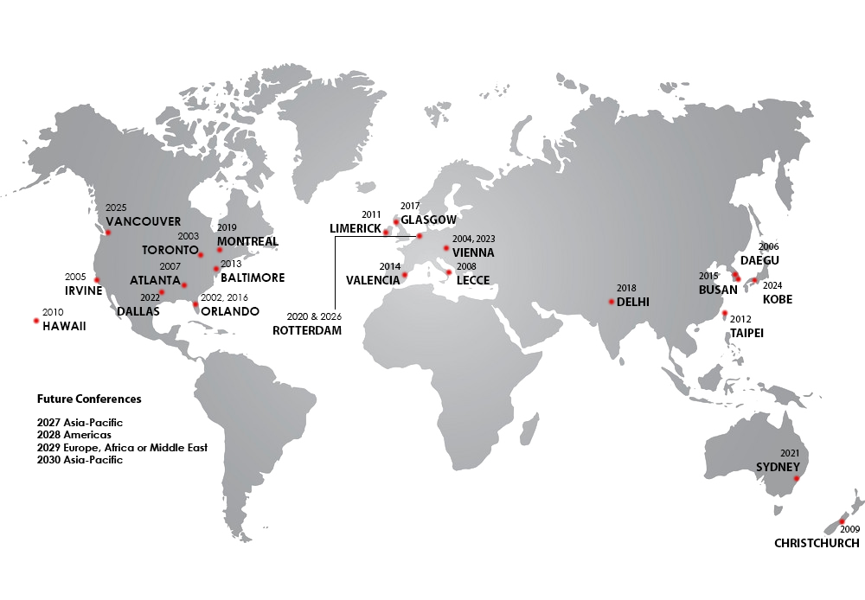

IEEE SENSORS Conference Locations
3-Year International Geographic Rotation
Americas
Europe/Middle-East/Africa
Asia/Pacific

Slide 9


Industry Focused Events
IEEE Sensor Interfaces Meeting
San Diego, CA, USA
April 25-26, 2024
IEEE Sensors in Spotlight
Boston, MA, USA
May 31, 2024

Slide 10




Publications
IEEE Sensors Journal
  Established 2001
  3M downloads in 2023
  Impact factor 4.325
IEEE Sensors Letters
  Established in 2017
  Rapid publication of short papers
Co-Sponsored Publications
  IEEE Journal on Flexible Electronics
  IEEE Internet of Things Journal
  IEEE Trans. on Agrifood Electronics
  IEEE Journal of Indoor and Seamless Positioning and Navigation
  IEEE Trans. on Radar Systems
  IEEE Trans. on Big Data
  IEEE Trans. on GAMES
Newsletter
  Published quarterly
  Reach of over 25,000 subscribers
IEEE Sensors Reviews
  Established in 2024
IEEE Journal of Selected Areas in Sensors (J-SAS)
  Established in 2023

Slide 11
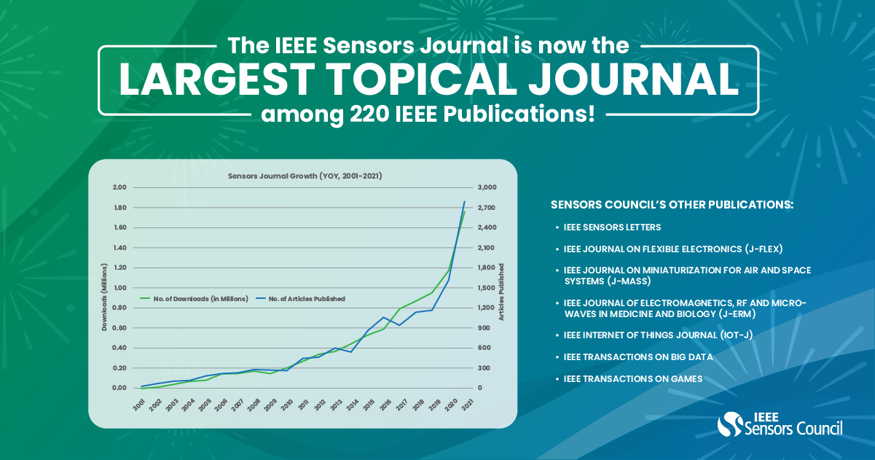
IEEE Sensors Journal

Slide 12
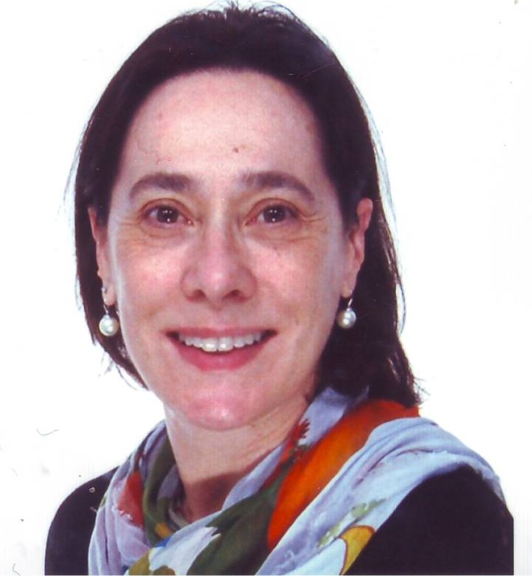
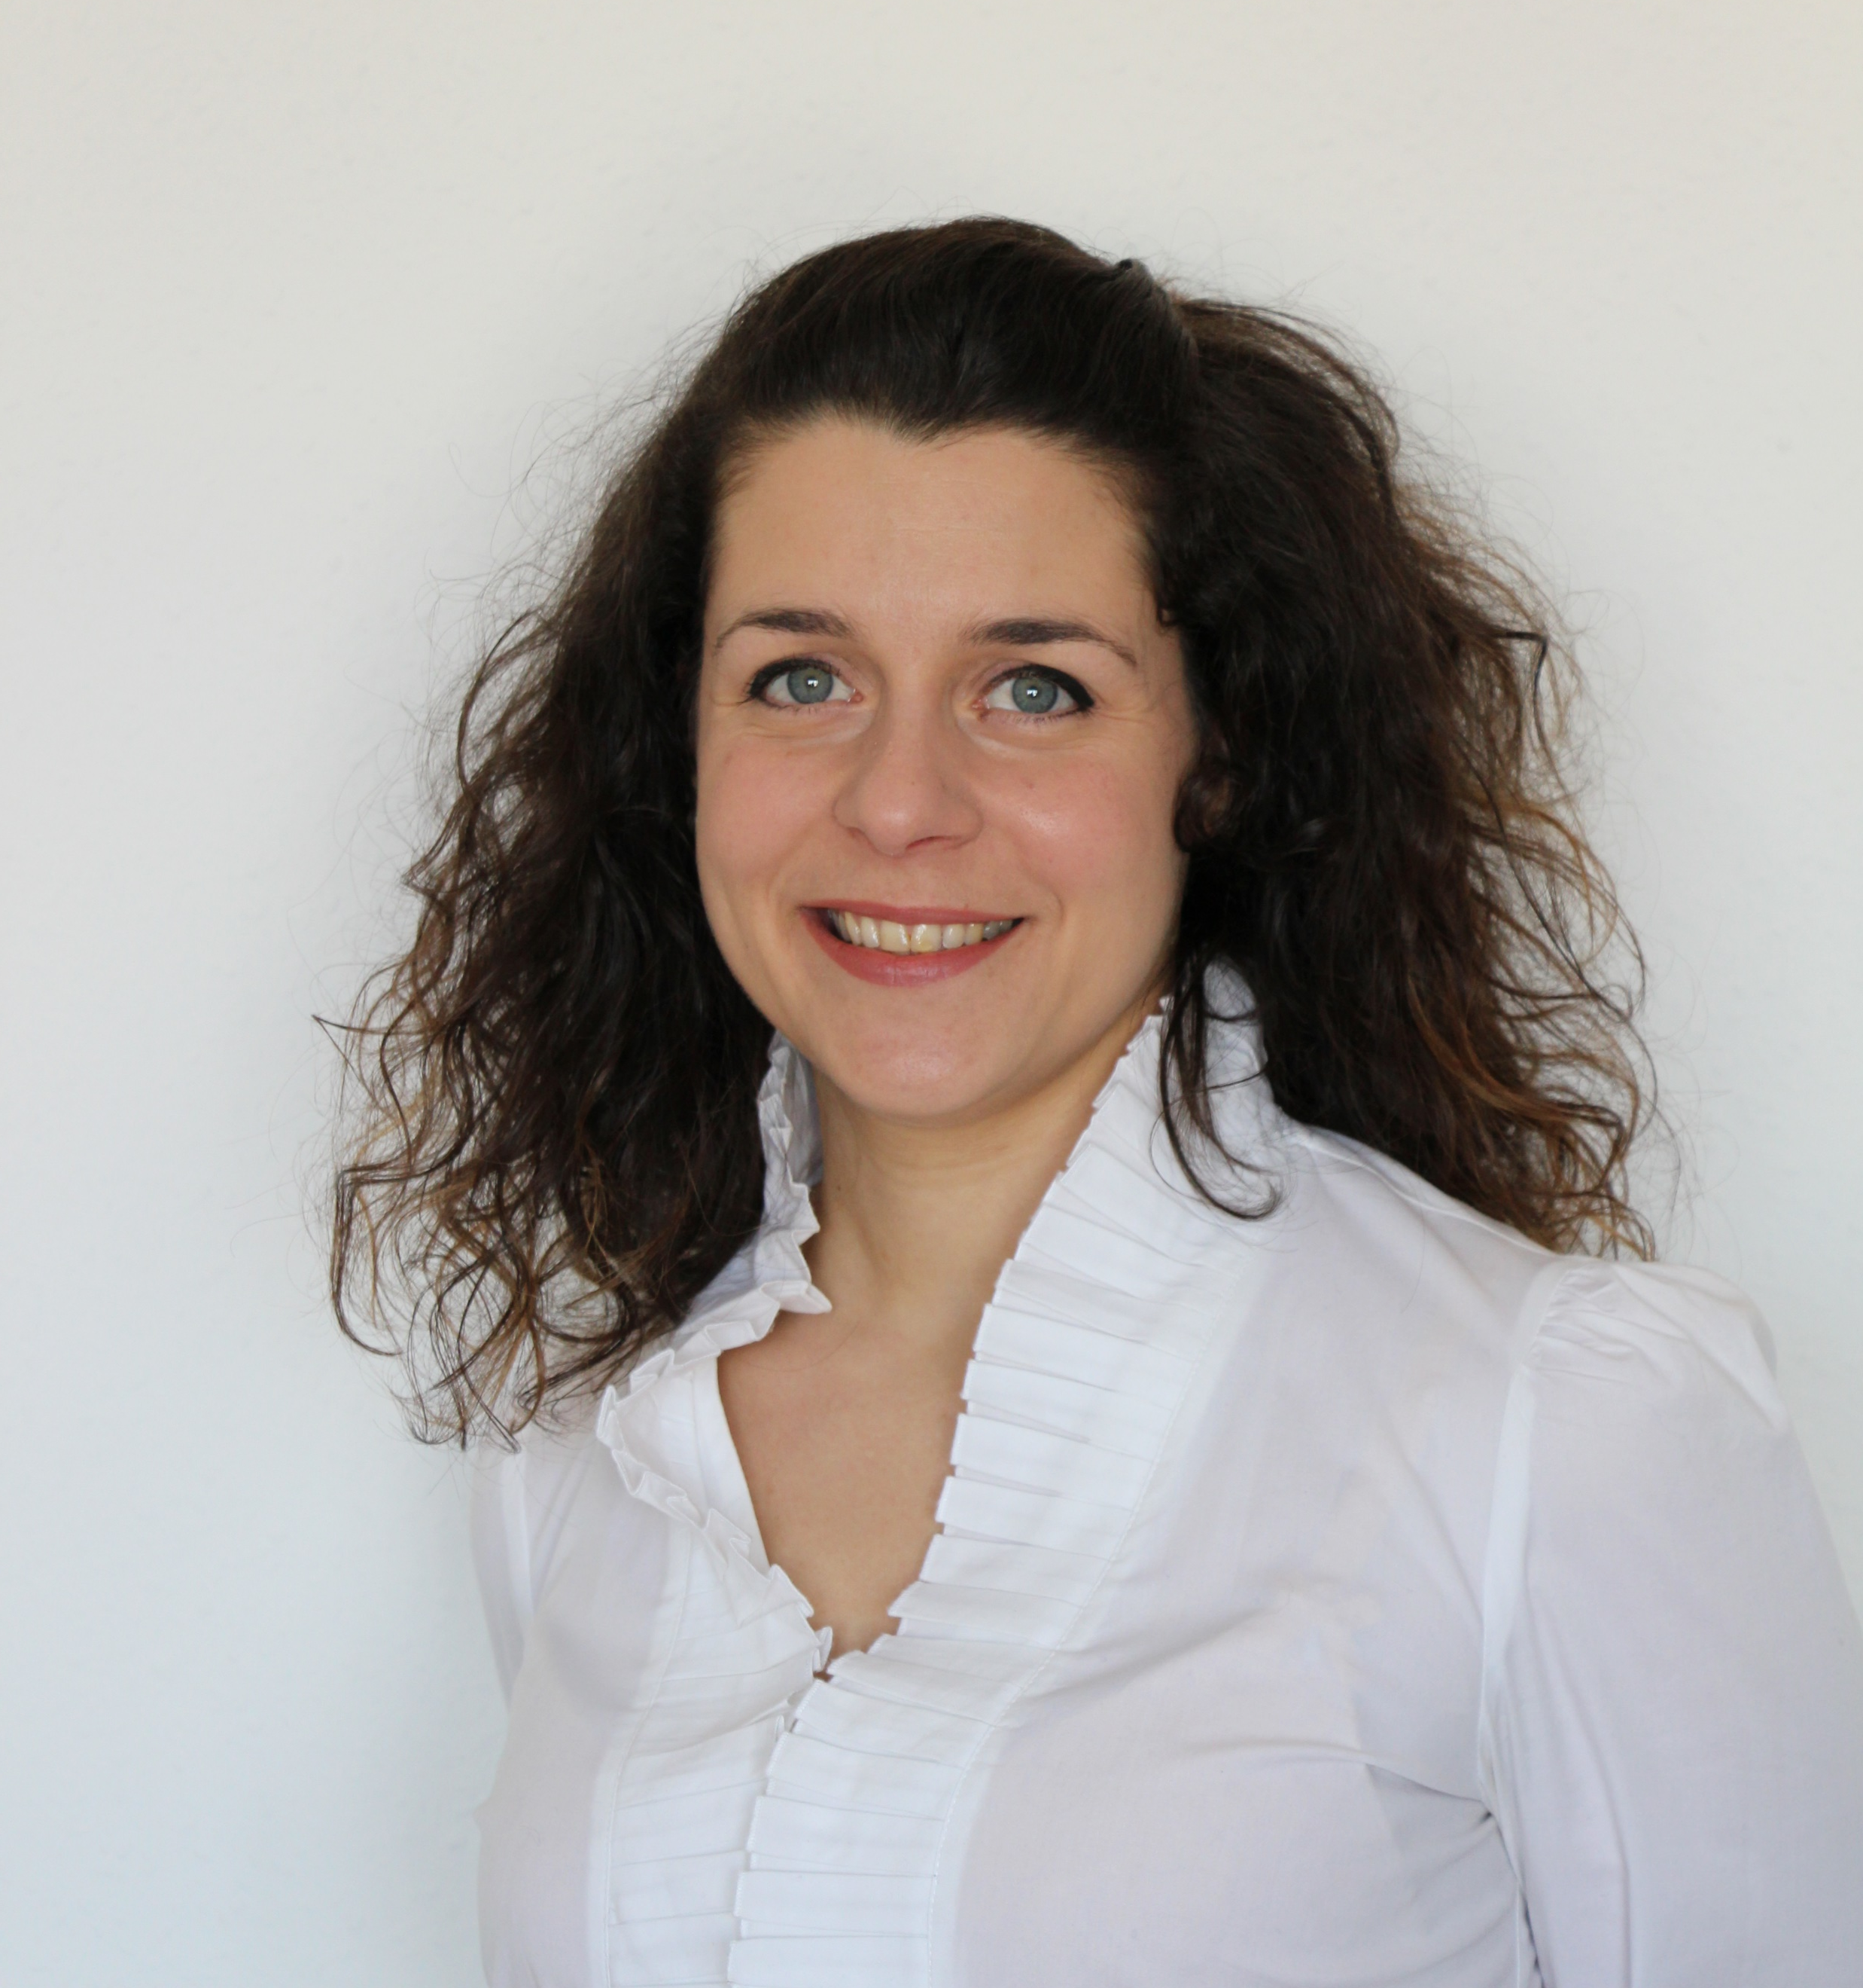
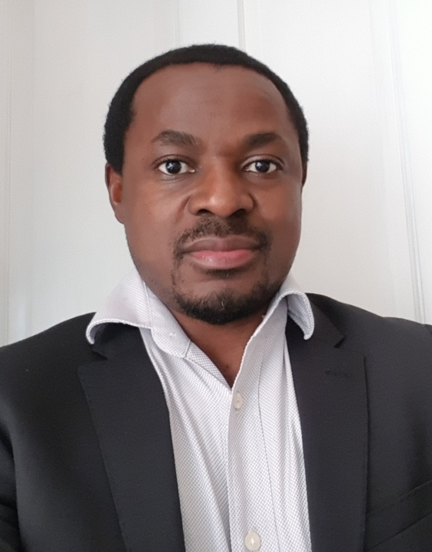
Committees
Diversity and Inclusion (D&I)
Chair: Anna Mignani
Objective: support the Sensors Council in ensuring activities and policies are supporting a diverse and inclusive environment
Women in Sensors (WiSe)
Chair: Paola Saccomandi
Objective: promote the presence and advancement of women in the profession of sensing technology, both in industry and academia
Young Professionals (YP)
Chair: Oliver Ozioko
Objective: promoting members who are within 15 years of receiving their degree by expanding their global network, elevating their professional image, and connecting to local peers

Slide 13
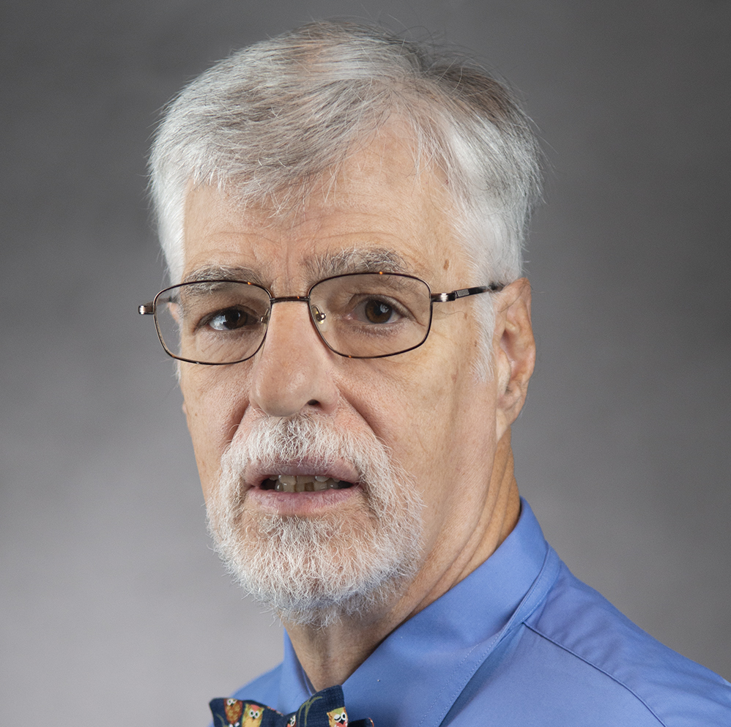
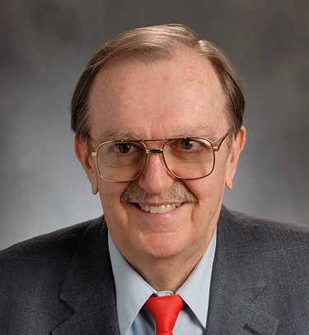
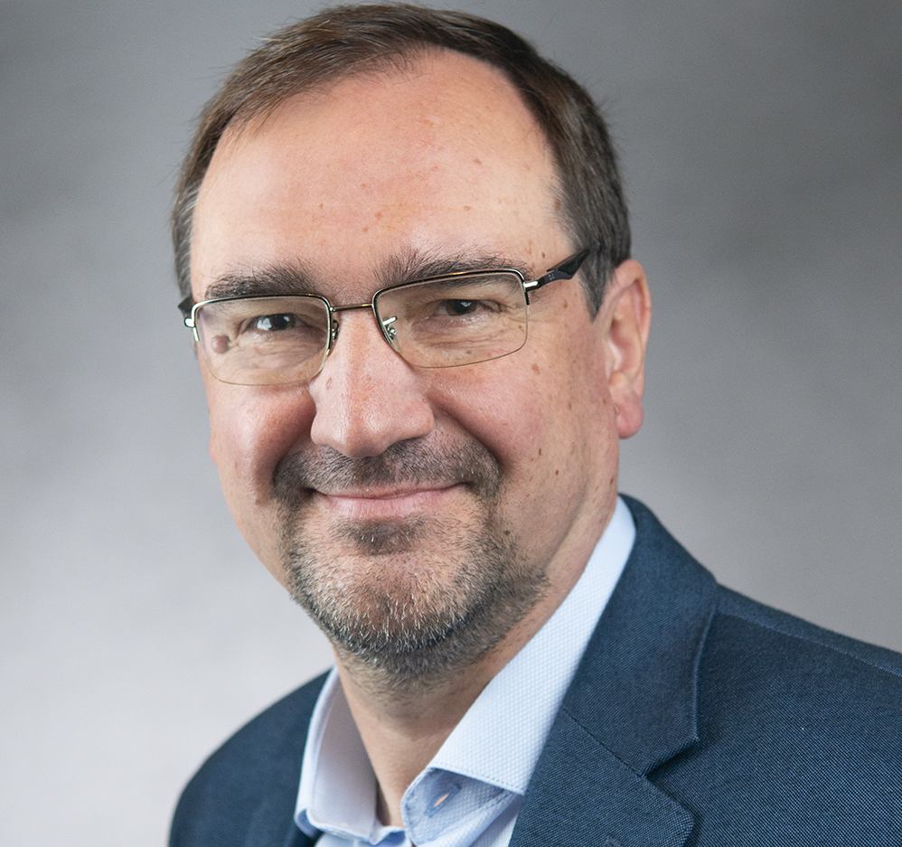
Committees
Industry Liaison Committee
Chair: Dan McGrath
Objective: drive industry engagement in sensors and establish an industry track at IEEE SENSORS
Standards Committee
Chair: Troy Nagle
Objective: to develop standards in sensors domain
SC-SC is currently developing 3 standards
Technical Committee in Inertial Sensors & Systems
Chair: Andrei Shkel
Objective: promote exchanges among researchers from academia, industry and government and identify the technologies and technical approaches to advance and mature the field of inertial sensors technology

Slide 14
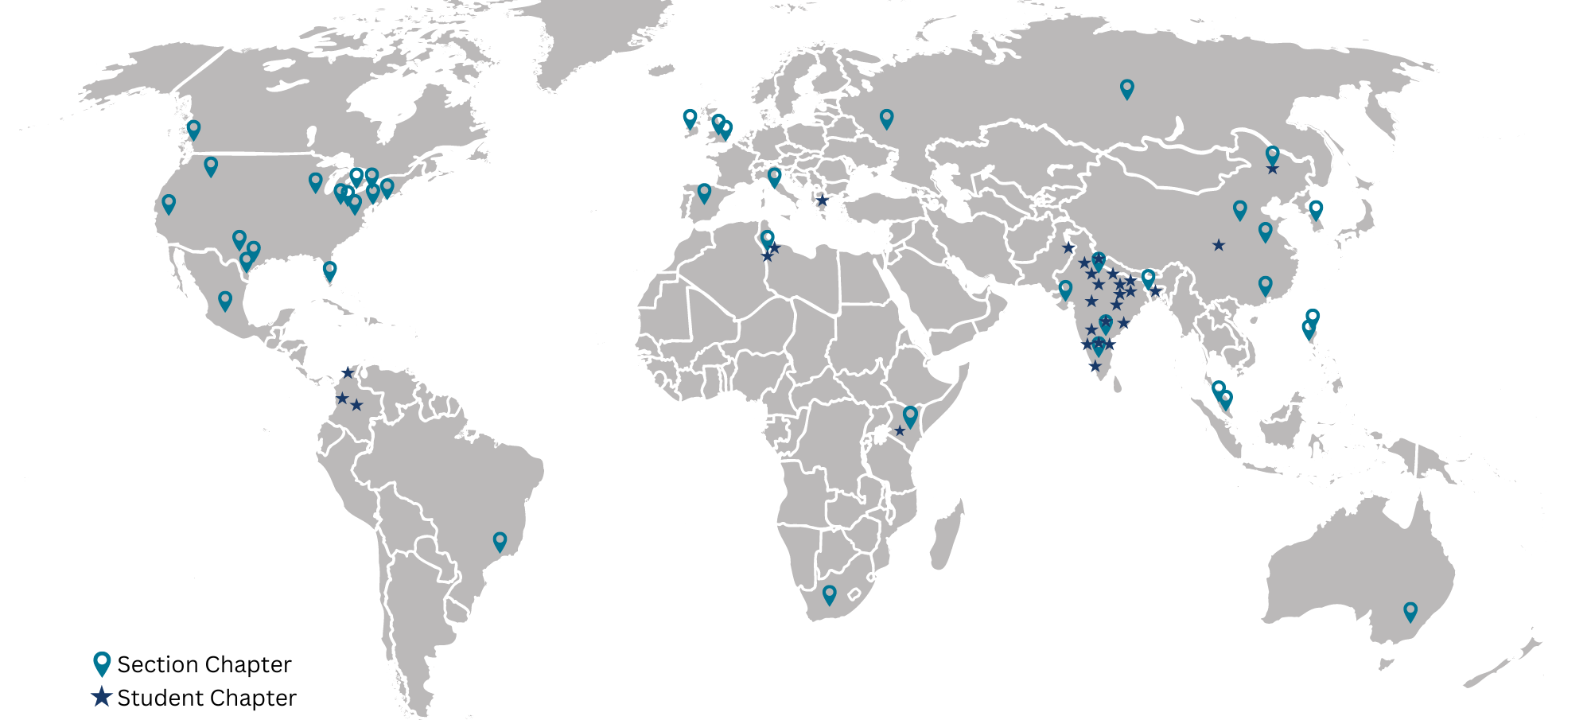
IEEE Sensors Council Chapters/Joint Chapter Locations
(as of February 2024)
44
Section Chapters
66
Student Branch Chapters
24
Countries
10
IEEE Regions

Slide 15



Distinguished Lecturer Program 2024
Objective
Highlights
Information
Access experts promoting the field of sensors.
Currently 14 DLs with various backgrounds and geo-locations
Online Biography and Talk Titles (addition of video)
Request a Distinguished Lecturer for your event by visiting the website and filling out the form.
Calls for new DLs are announced on the website and social media.
ieee-sensors.org/distinguished-lecturer-program

Slide 16
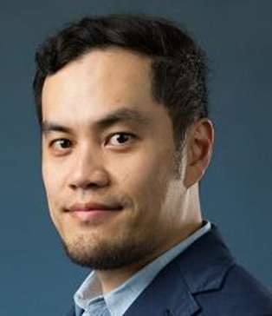
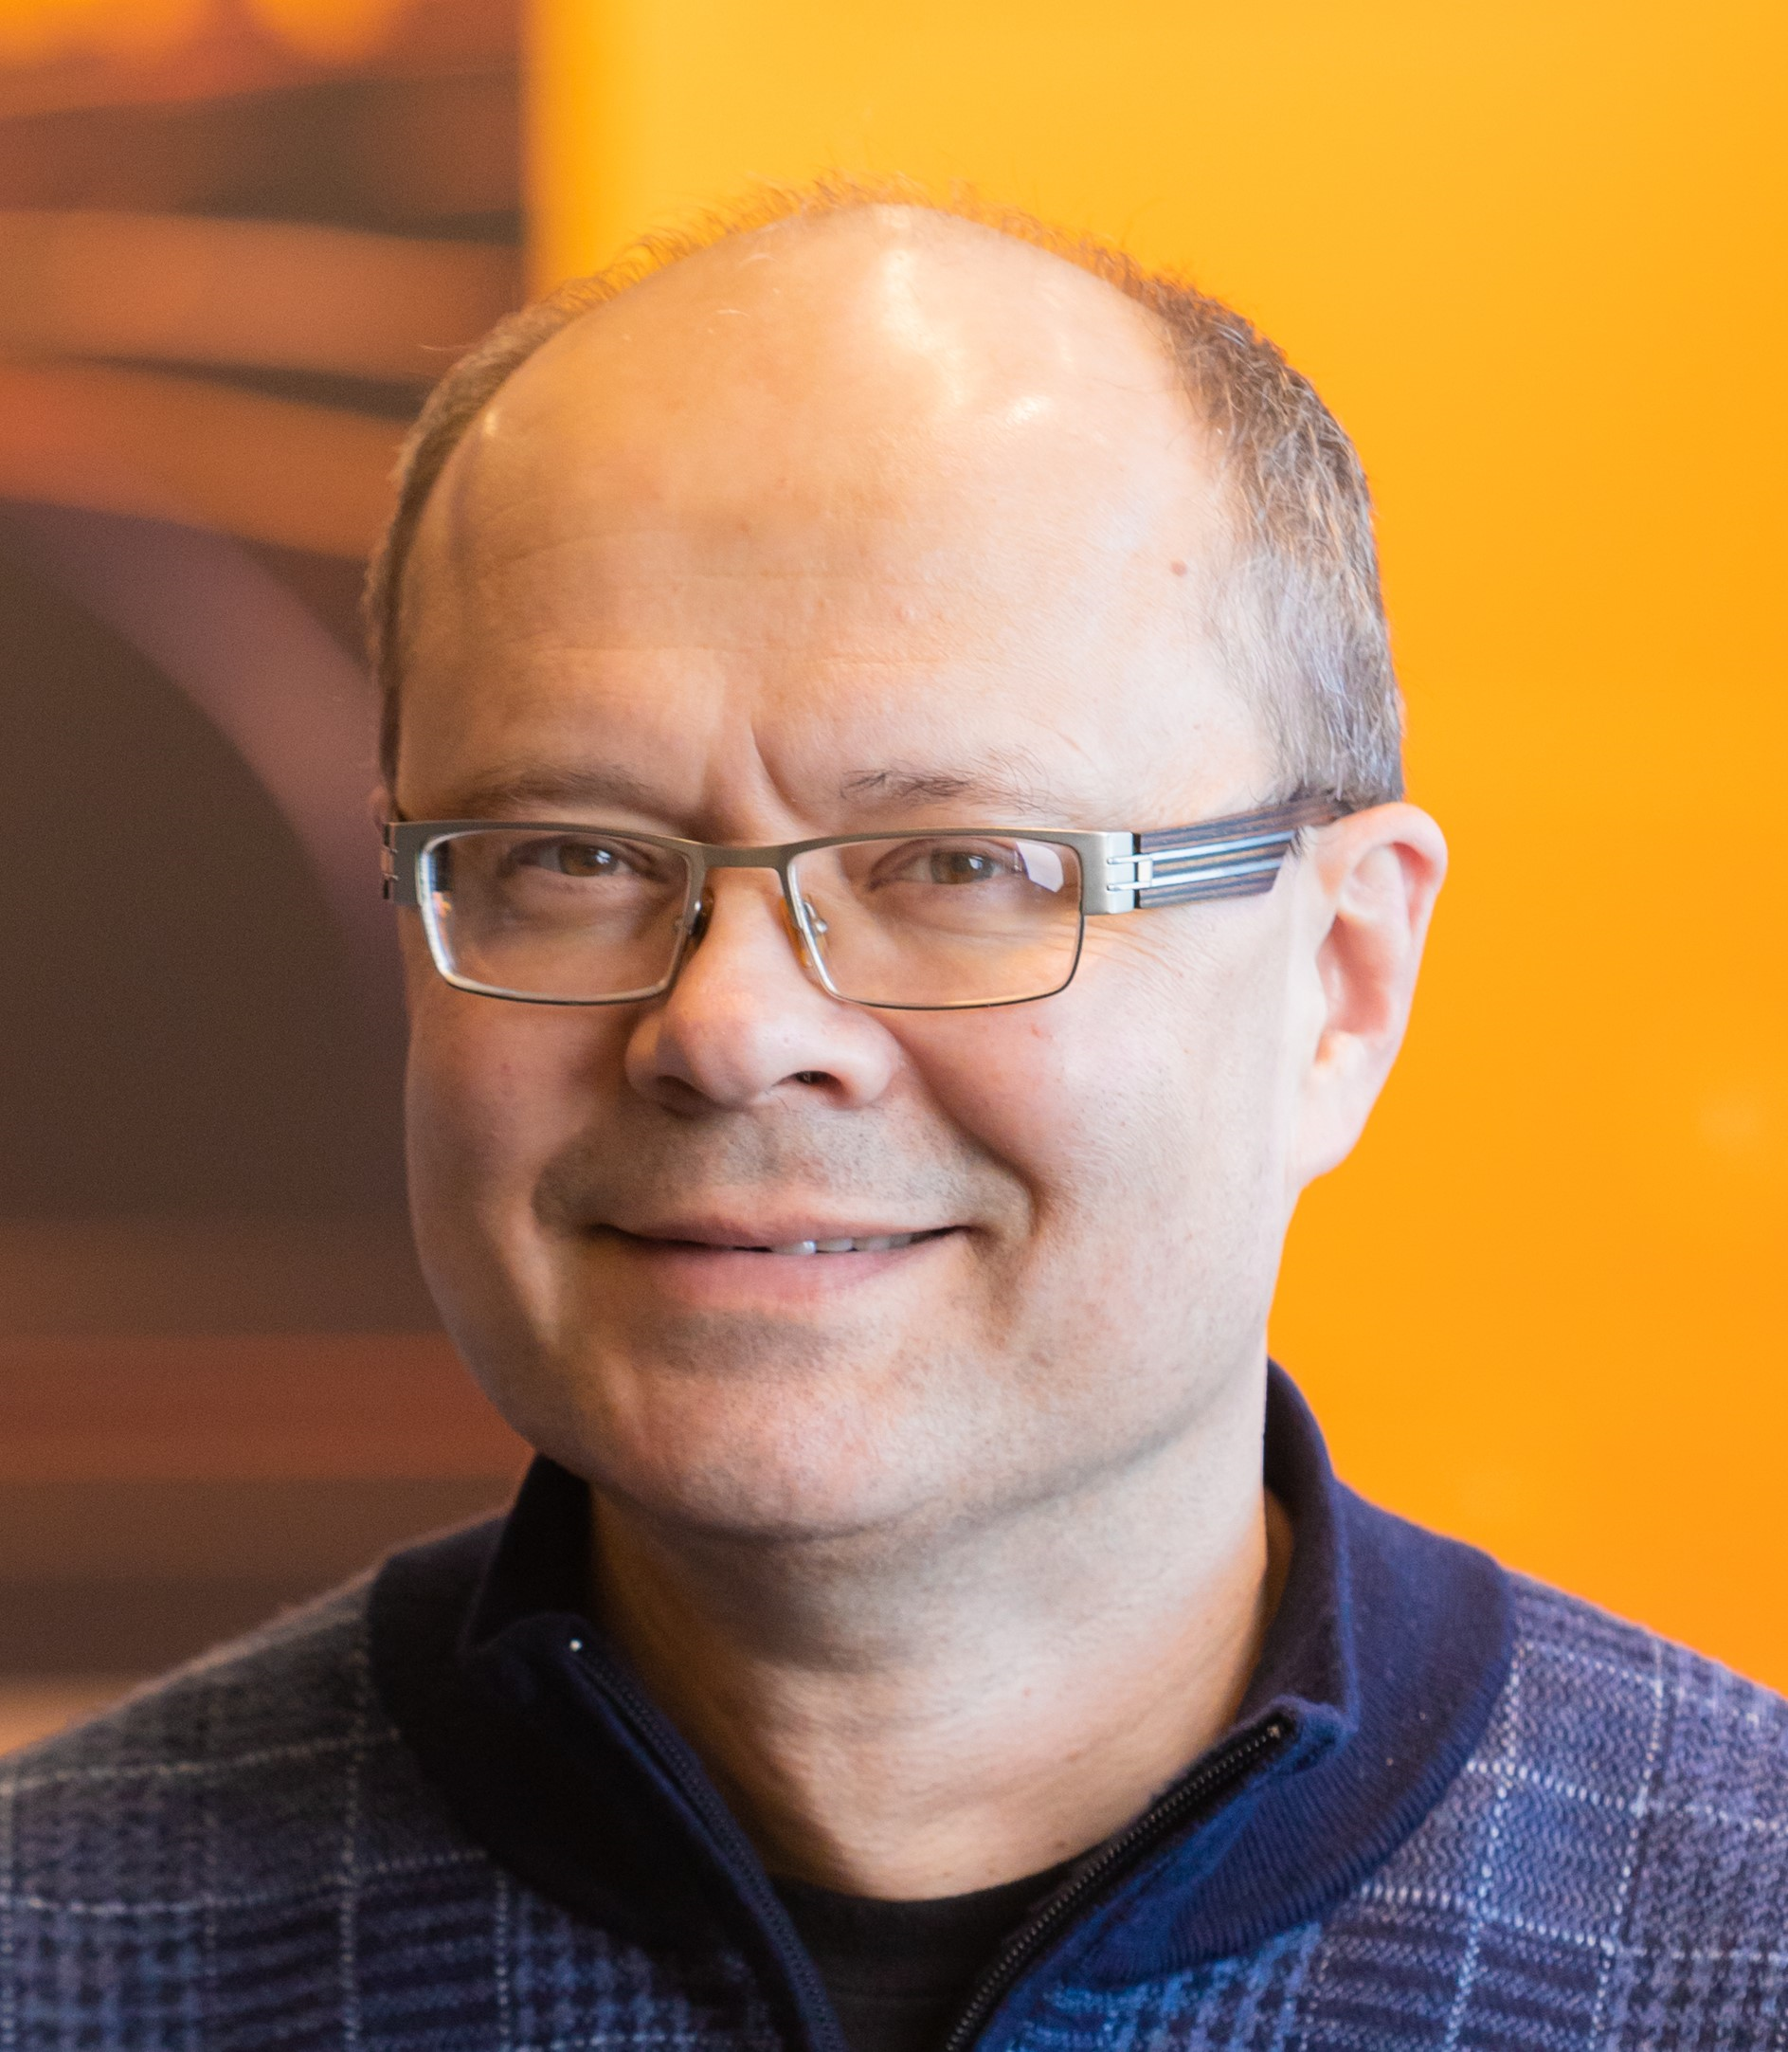
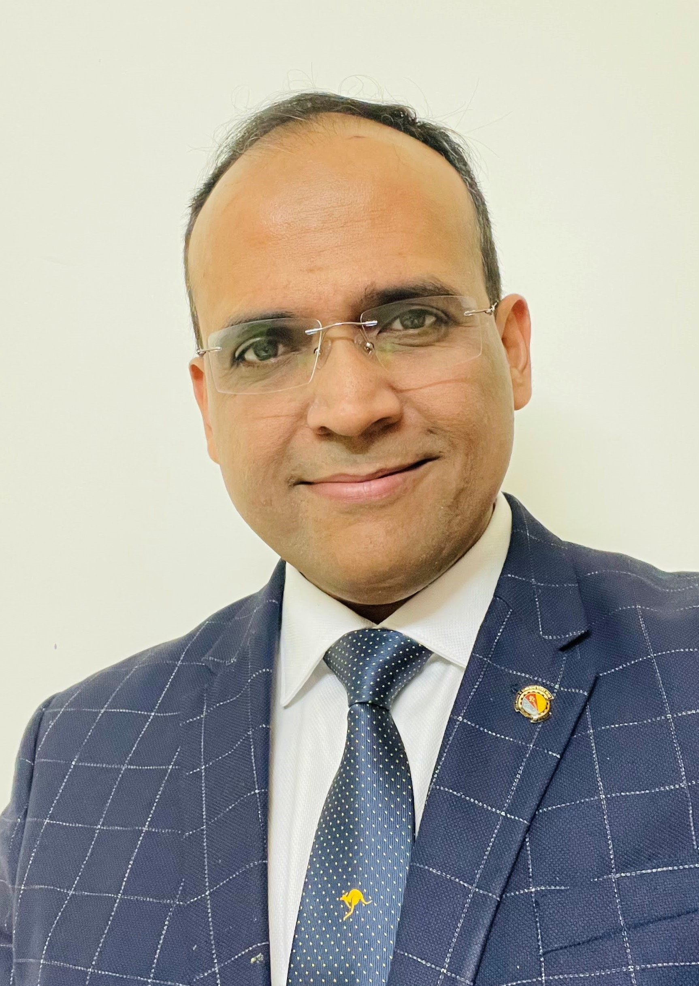
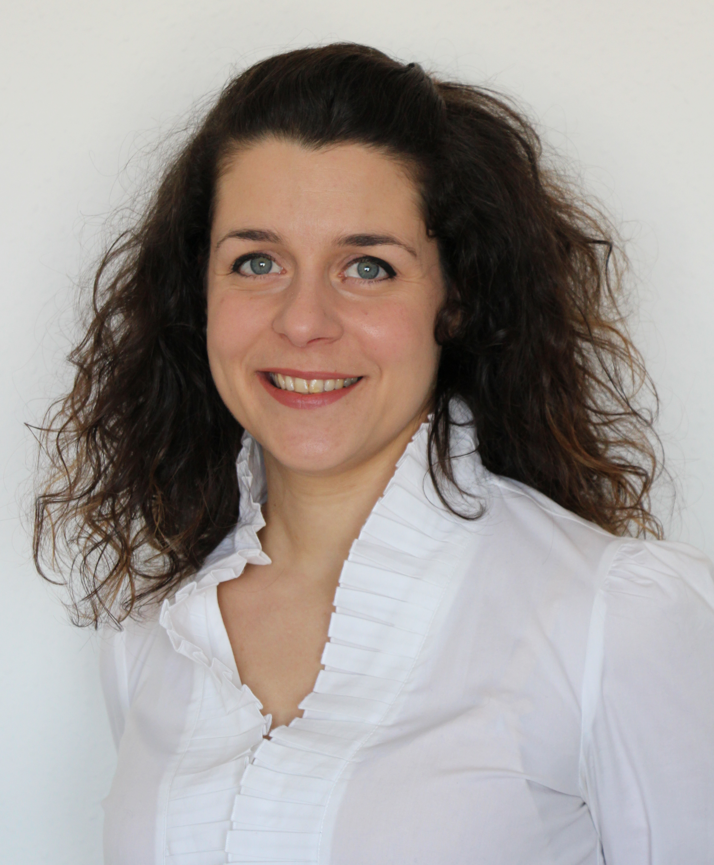
Distinguished Lecturer Program | Class of 2024-2026
Pai-Yen Chen
University of Illinois
Chicago, Illinois, USA
Zero-Power Wireless Micro- Nano-Sensors for Internet-of-Things Applications
Radislav Potyrailo
GE Research
Niskayuna, NY, USA
Next Generation of Gas Sensors: Anticipated and Unanticipated Advantages Over Last-Century Designs
Unconventional Excitation of Interfaces Enables Exquisite Gas Sensing For Our Sustainable Future
Sanket Goel
Birla Institue of Technology and Science (BITS)
Pilani, Hyderabad, India
Human-Robot Interaction and Human-Robot Teams
Portable Optofluidic Devices for Autonomous and Diversified Sensing Applications
Paola Saccomandi
Politecnico di Milano
Milan, Italy
The new thermometry with light: fiber optic sensors and novel imaging technologies for monitoring thermal-based therapies for localized tumors
Fiber optic sensors for healthcare applications: fundamentals, applications and frontiers

Slide 17
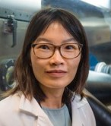
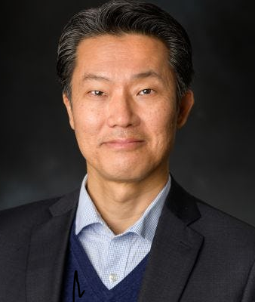
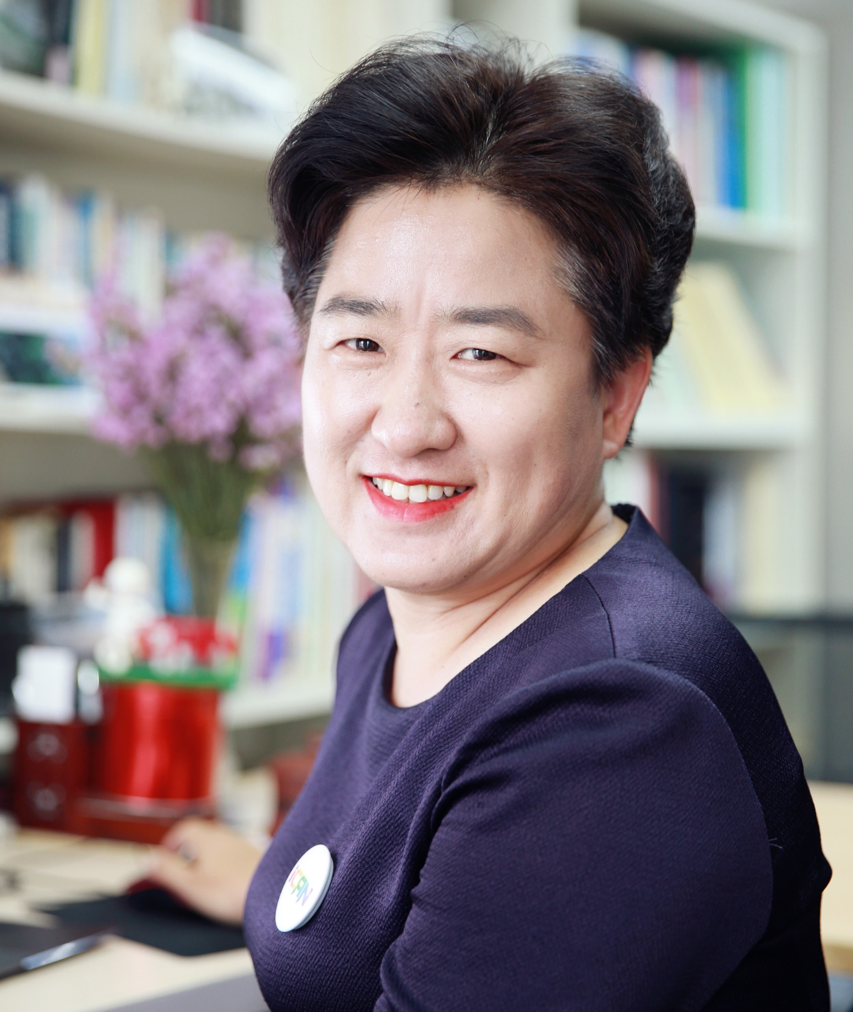
Distinguished Lecturer Program | Class of 2023-2025
Tina Tse Nga Ng
University of California
San Diego, USA
Emerging Designs for Polymer-Based Optoelectronics and Wearables
Eui-Hyeok Yang
Stevens Institute of Technology
New Jersey, USA
2D Materials and Flexible Electrodes for Sensing Applications
Haixia (Alice) Zhang
Peking University
Beijing, China
From Alice to Alita: Adventure of Self-Powered Smart System

Slide 18
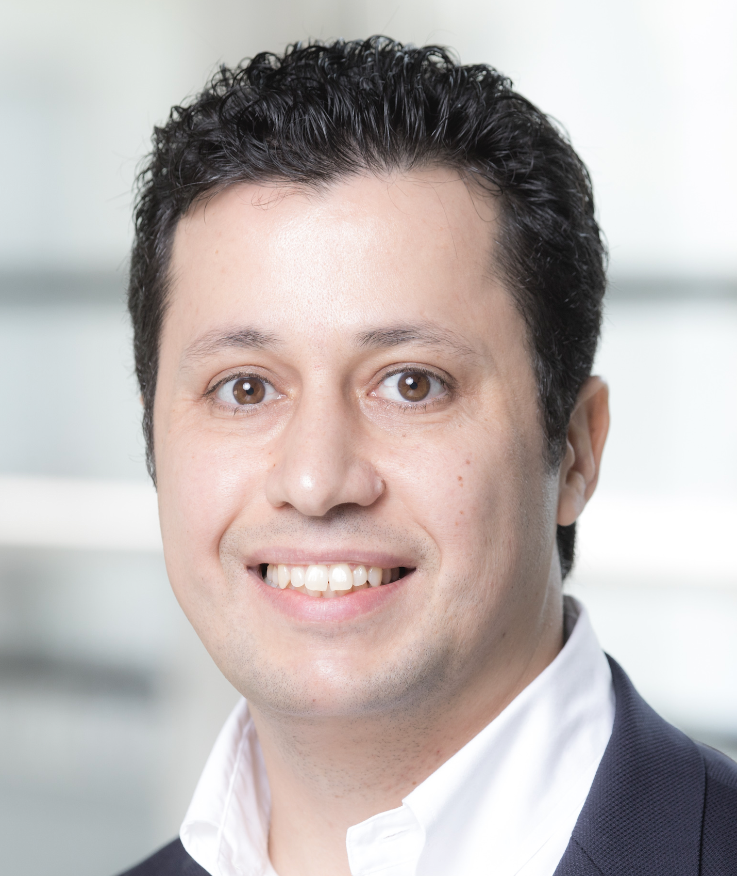
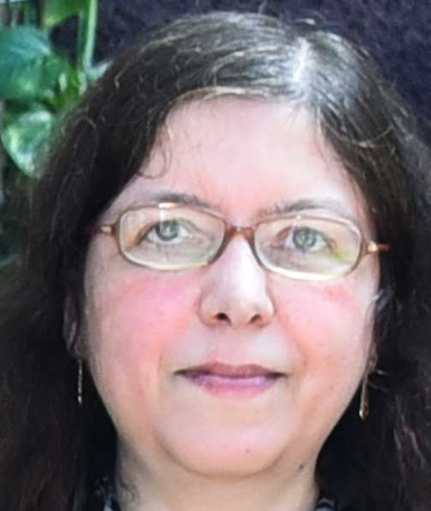
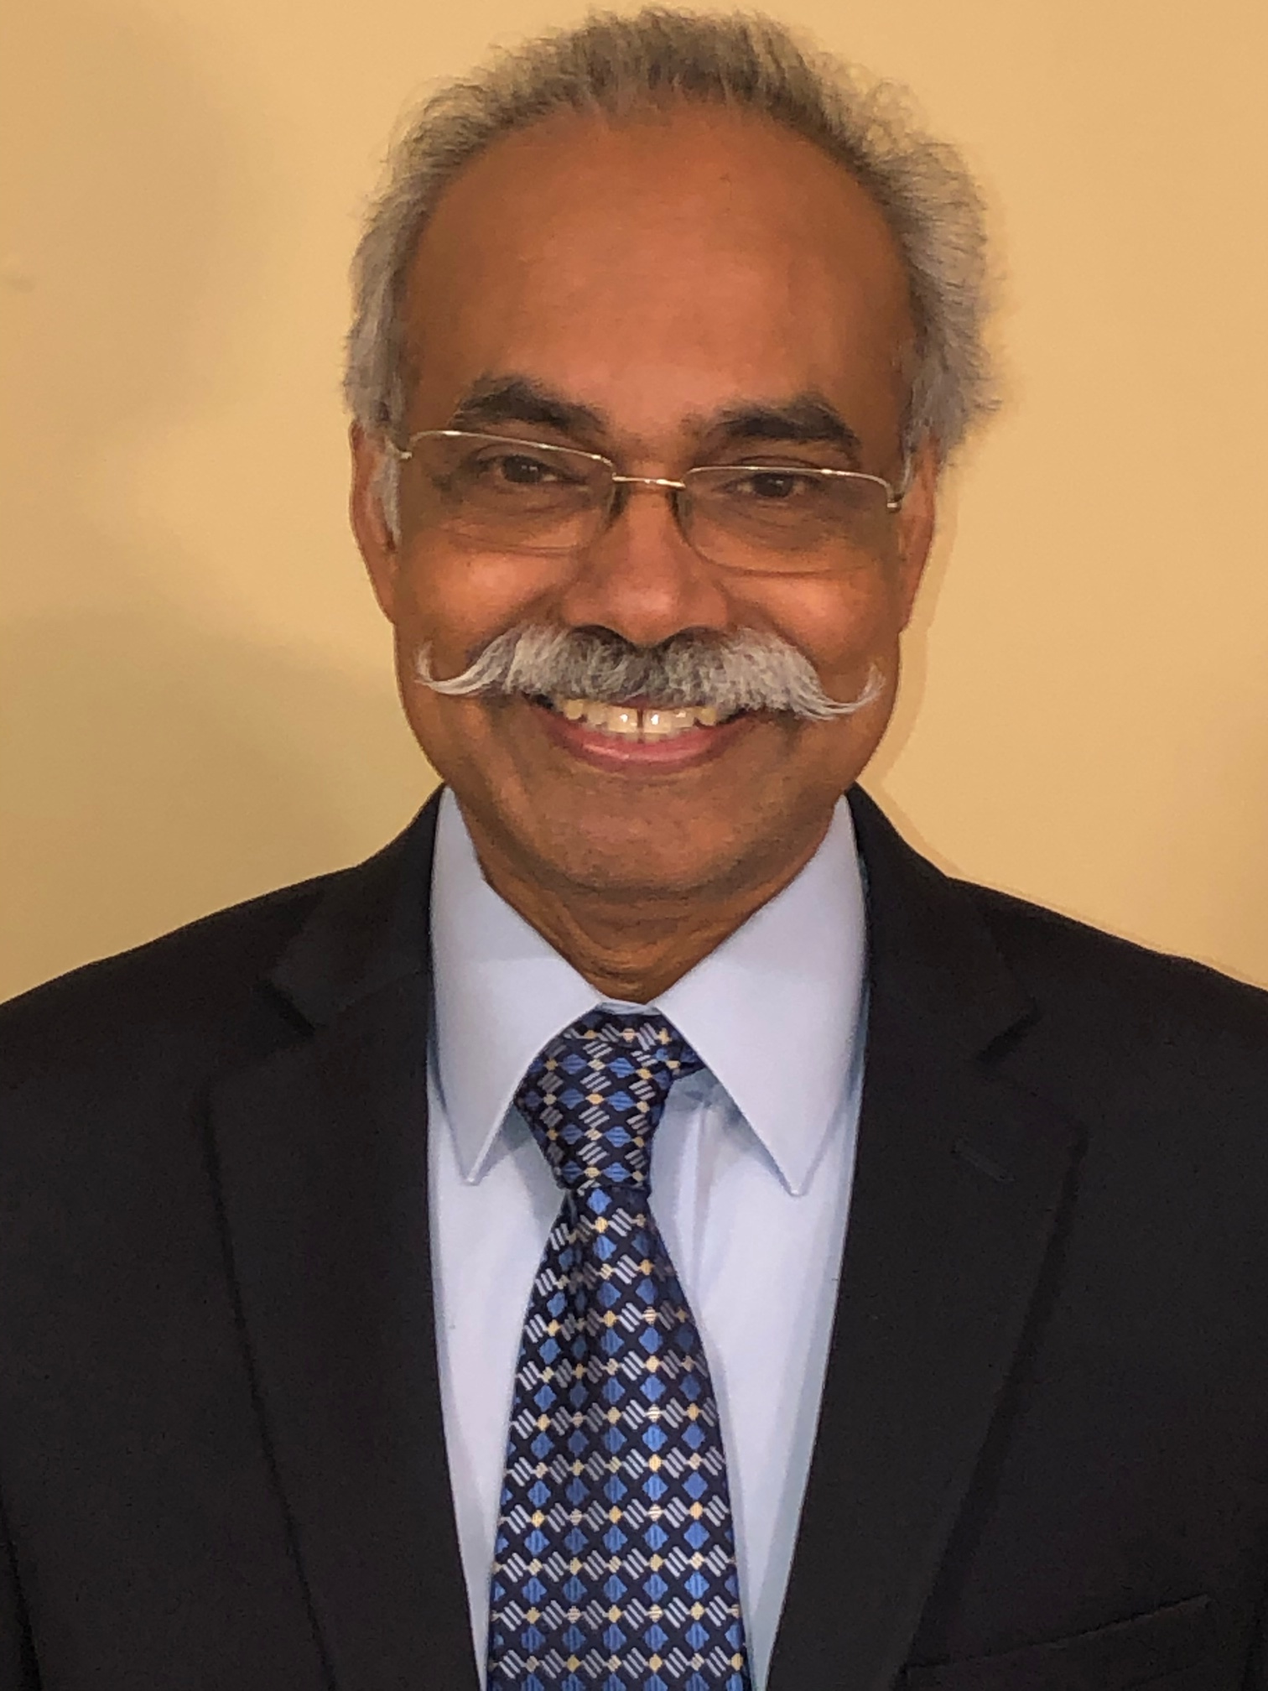
Distinguished Lecturer Program | Class of 2022-2024
Pantelis Georgiou
Imperial College
London, UK
Microchip Technology enabling Rapid Diagnostics for Infectious Diseases – From AMR to COVID-19
Maryam Shojaei Baghini
Indian Institute of Technology
Bombay, India
Frequency based Portable Particulate Sensing: System and Frequency Estimation
Sub-100 ppm Auto-calibrated Fiftyfold Range Resistive Sensor Measurement ASIC and System
Thomas Thundat
University at Buffalo
Buffalo, NY, USA
Addressing the Molecular Selectivity Challenges in MEMS Chemical and Biological Sensors
Delivering Electrical Power to Distributed MEMS Sensors for Battery-free Operation

Slide 19
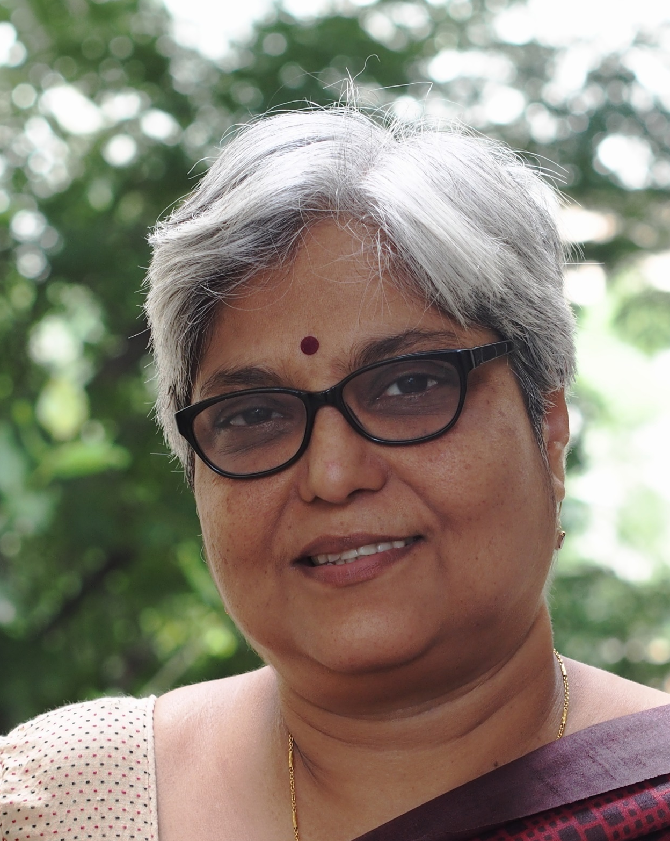
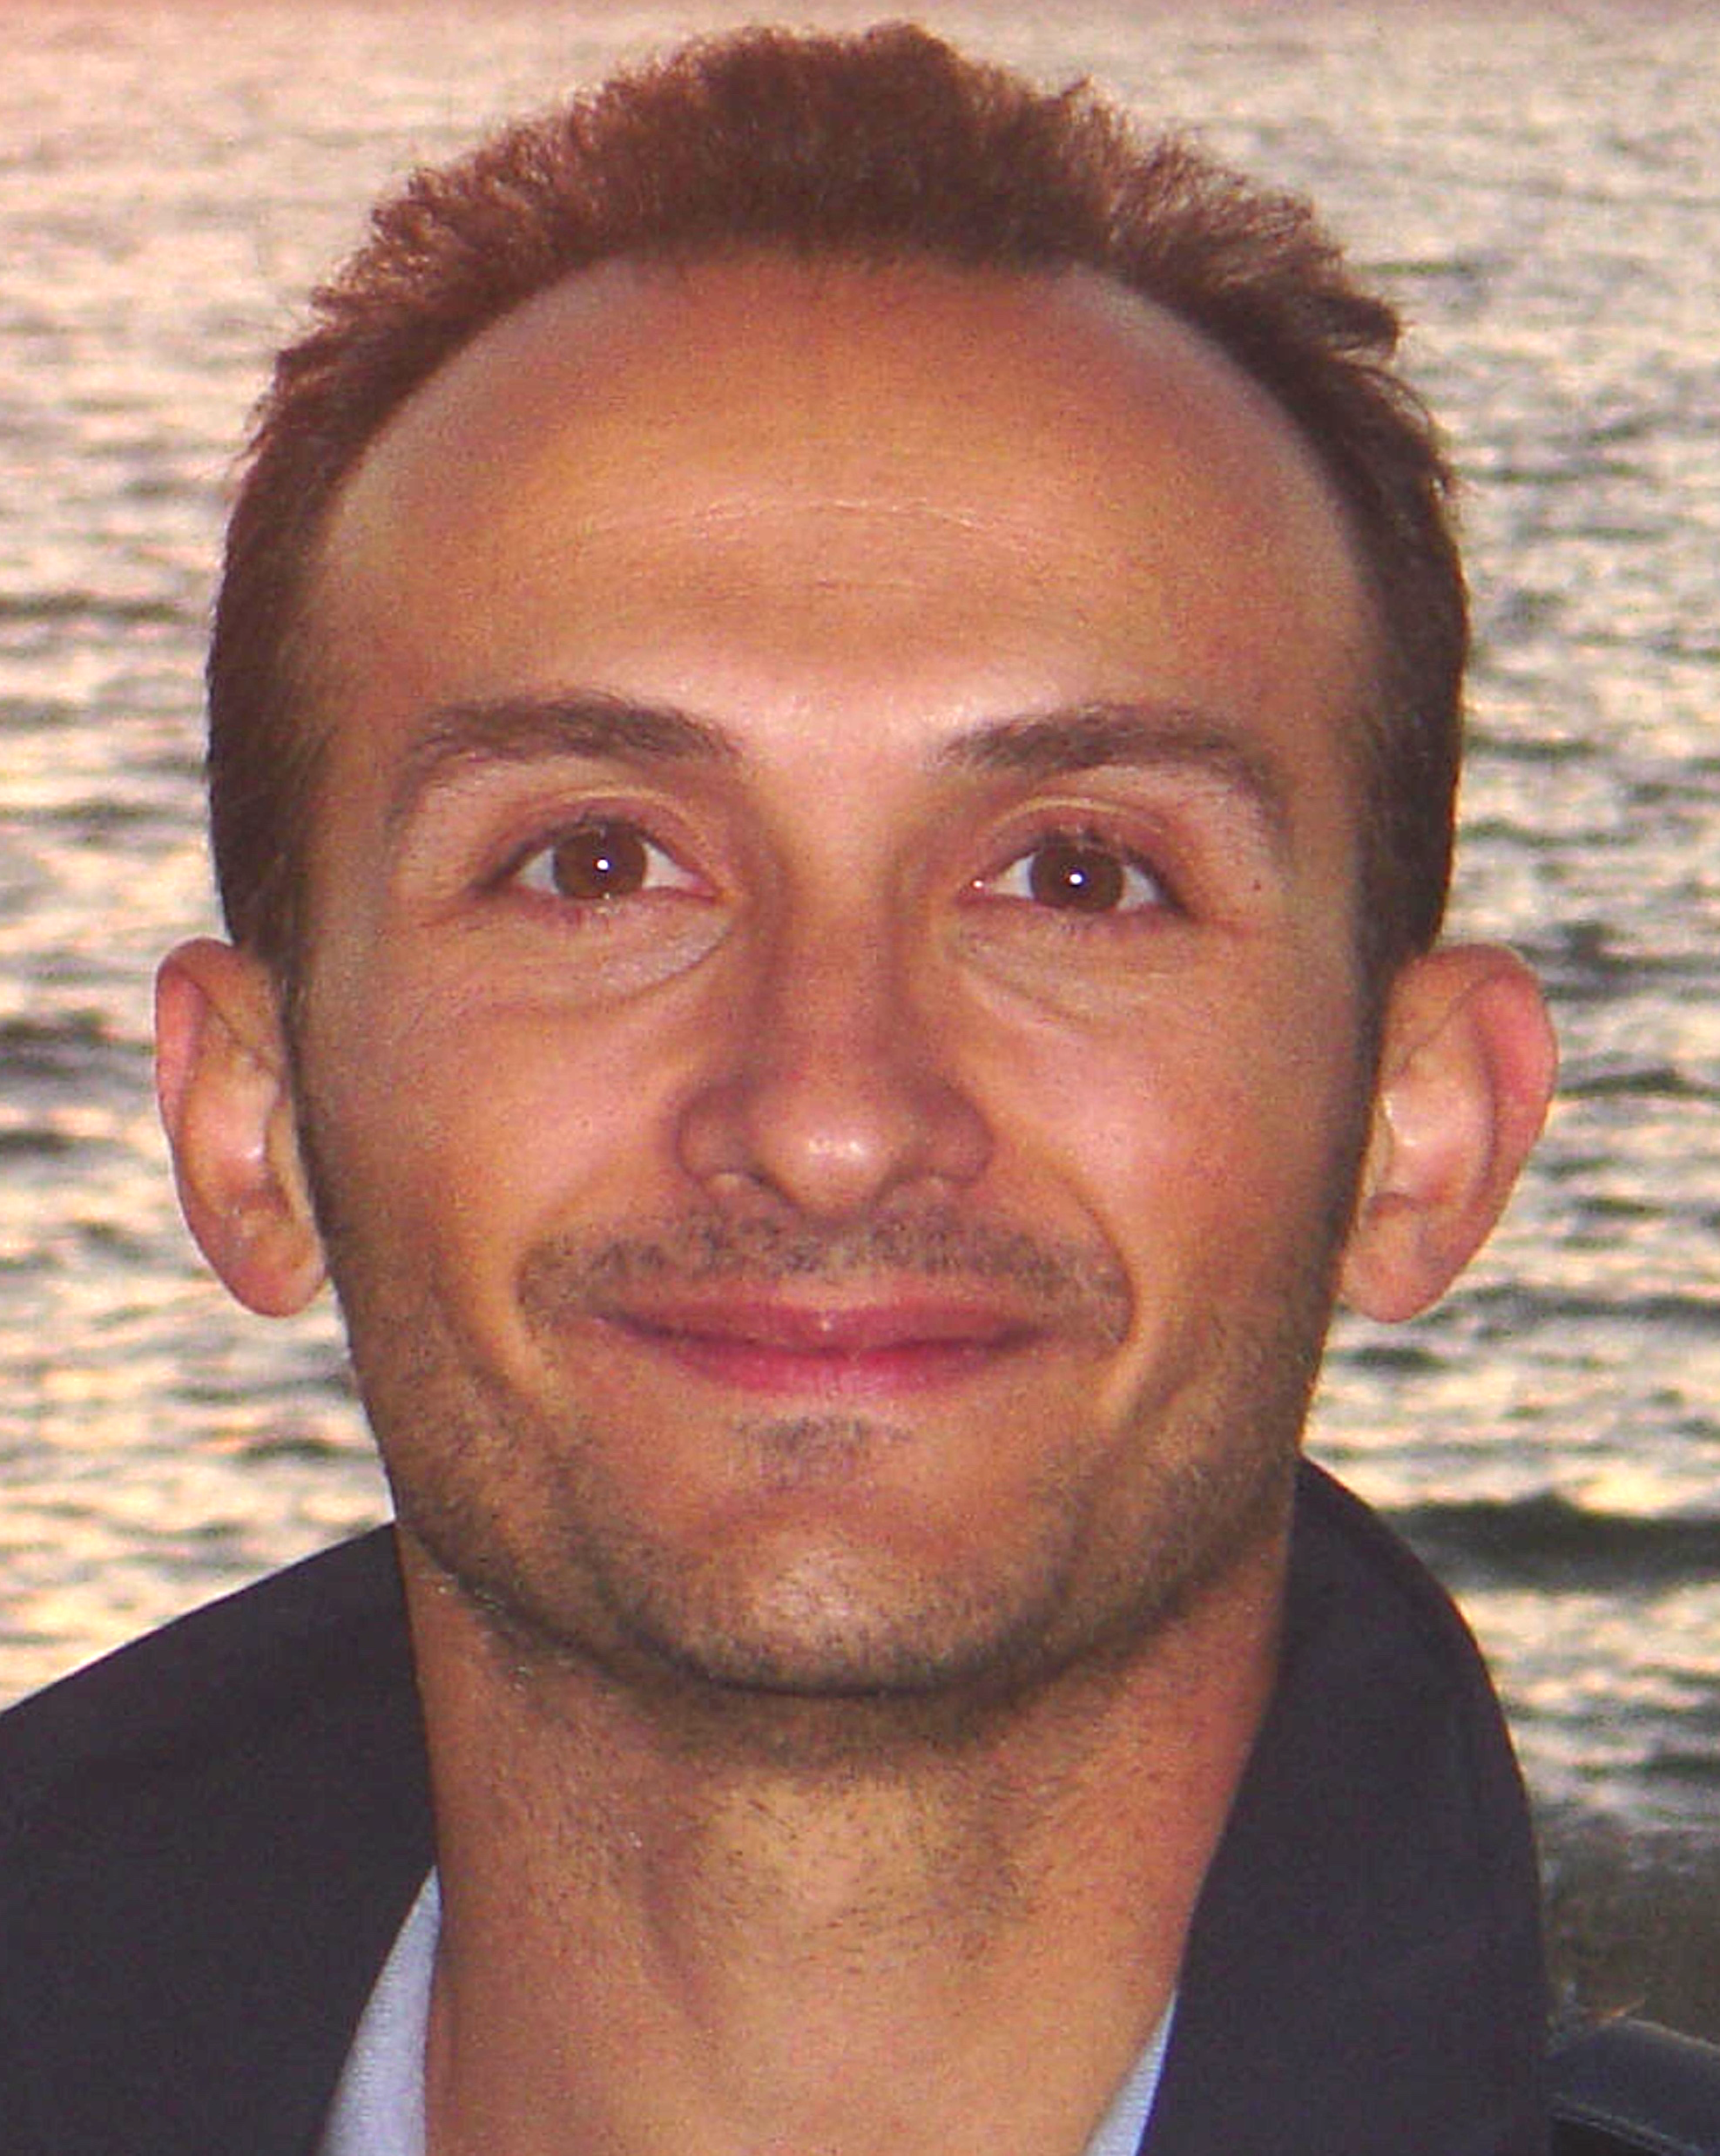
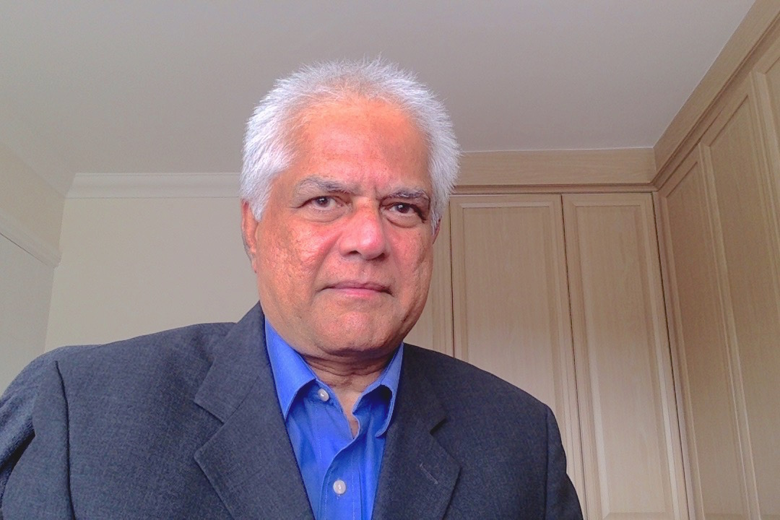

Distinguished Lecturer Program | Class of 2021-2024
Enakshi Bhattacharya
Indian Institute of Technology Madras
Chennai, India
MEMS Pressure Sensors
Miniaturised Electrochemical Silicon Biosensor System for the Detection of Triglycerides
High Sensitivity Bio-sensing in Liquids with Resonant Mode Cantilevers
Giancarlo Fortino
University of Calabria
Rende, Italy
Wearable Computing Systems based on Body Sensor Networks: State-of-the-art and Future Research Challenges
Collaborative Body Sensor Networks and Their Application for Pervasive Humans’ Tracing to combat Pandemics
Vladimir Lumelsky
NASA – Goddard Space Flight Center
Greenbelt, MD, USA
Human-Robot Interaction and Human-Robot Teams
Arokia Nathan
University of Cambridge
Cambridge, England
Ultra Low Power Sensor Interfaces for IoT

Slide 20
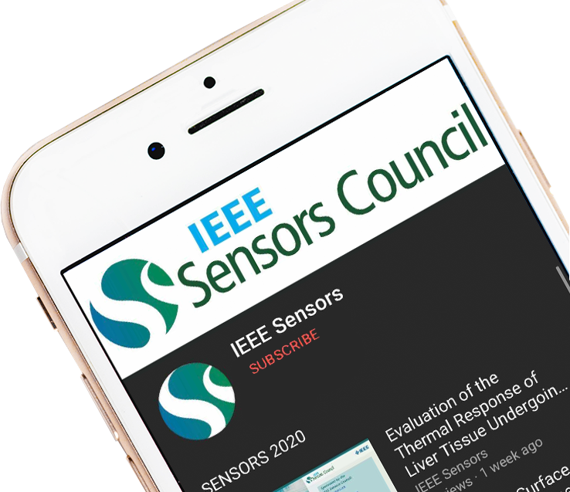

YouTube Education
The Sensors Council YouTube channel has over 271,000 views and over 4,700 subscribers as of January 2024. The channel features live demonstrations, conference tutorials, plenary talks, invited/keynote talks, oral presentations, DL talks and more.
Bit.ly/SensorsCouncilYouTube

Slide 21





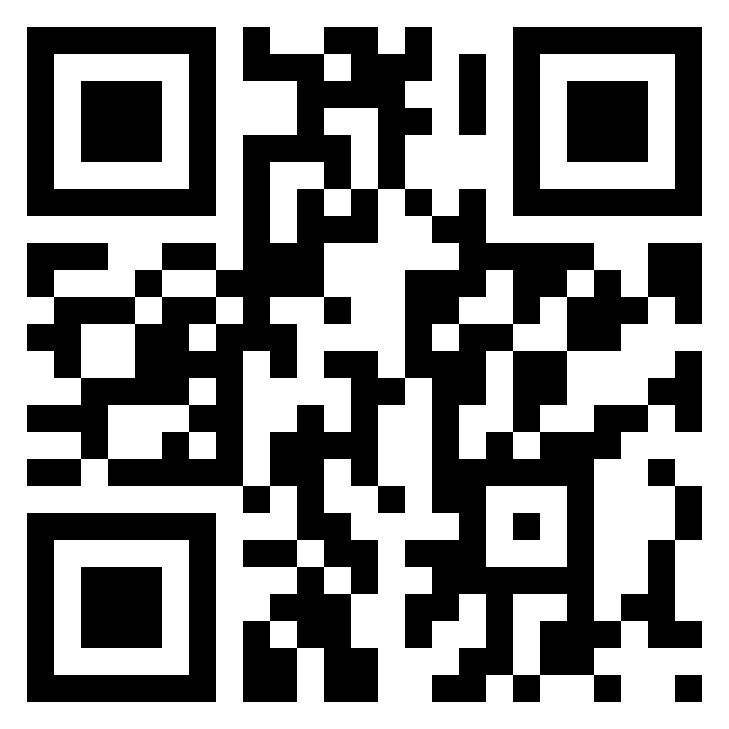


Website
ieee-sensors.org
Facebook
facebook.com/IEEESensorsCouncil
X (Twitter)
@SensorsCouncil
LinkedIn
Stay up to date on Sensors Council news and events!
linkedin.com/company/ieee-sensors-council
YouTube
Bit.ly/SensorsCouncilYouTube
Publicity Resources
ieee-sensors.org/publicity-documents/

